Slide 1


Welcome to
St James C of E Primary School

Slide 2



Our School Vision and Values
Children are at the centre of everything that we do.
This is underpinned by our vision of
'Let us love...Let us thrive'
and core values of
love, friendship, respect, endurance,
honesty, peace.

Slide 3
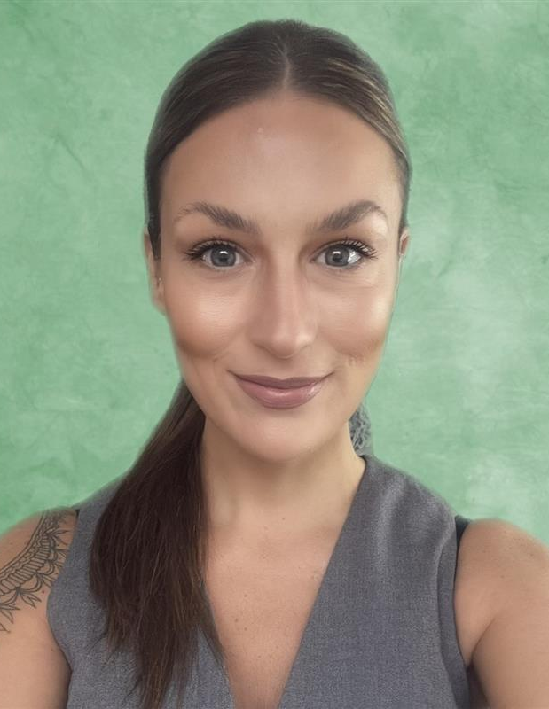
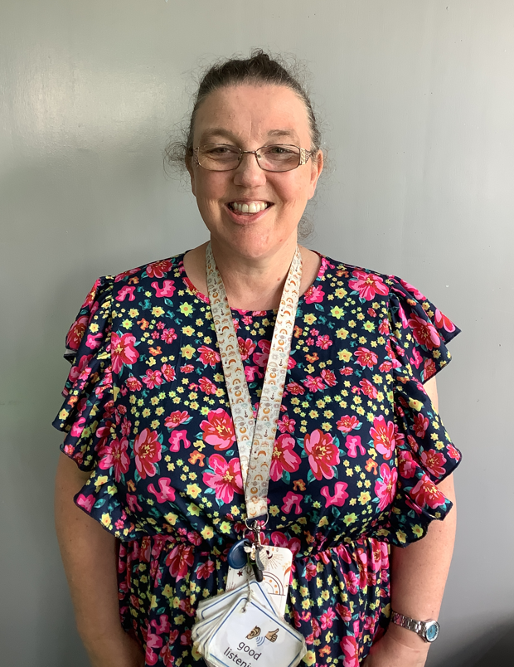
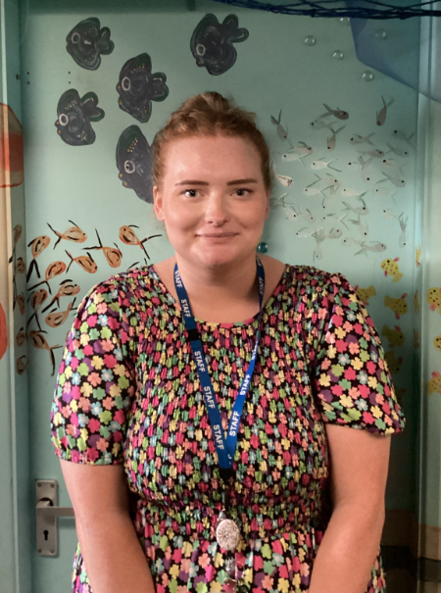
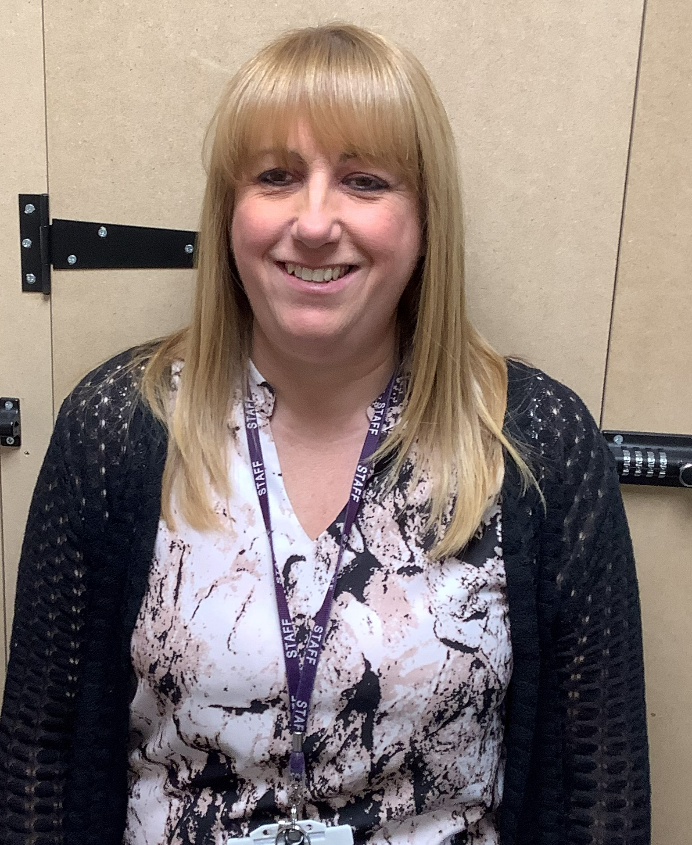


Meet the Reception team…
Mrs Zmitrowicz Mrs Hayward Miss Smith Mrs Plant

Slide 4

The rest of the team…. Parents
Parents and school, working together as partners in your child’s learning…..
Share your child’s interests, talents, abilities with your child’s teacher / keyworker. This enables us to tailor the curriculum to meet your child’s needs and plan lessons that will be exciting and engaging for your child.
Throughout the year you can reinforce the skills your child is developing – therefore helping to consolidate learning.

Slide 5
Starting Reception- Transition
Home visits (if your child is new to St James)
Wednesday 2nd, Thursday 3rd September
An informal opportunity for your child to meet their new teachers in the comfort of their own home.
Visits to school – Stay and Play Sessions –
Friday 4th September
You and your child visit the Reception classroom environment and have the opportunity to meet other parents and children.
Transition week – week commencing 7th September
Half day sessions for half of the Reception class
Wed 9th Sept- 840-1230 -All children including lunch
In school full time – Thursday 10th September onwards

Slide 6



EYFS Educational Programmes
Prime Areas of Learning
Personal, Social and Emotional – self regulation, self care, relationships, feelings, self confidence and developing independence
Physical Development – P.E. fine motor control, including pencil control, using scissors and gross motor control.
Communication and Language – Listening, attention, understanding and speaking
Specific Areas
Literacy – word reading, comprehension and writing
Mathematics – numbers, numerical patterns
Understanding the World – history (past and present), our natural world (geography), people, culture and communities
(geography and R.E)
Expressive Arts and Design – exploring media, being imaginative
Statutory Assessments – Baseline assessment (first six weeks of starting school). EYFS Profile assessed at the end of Reception.

Slide 7



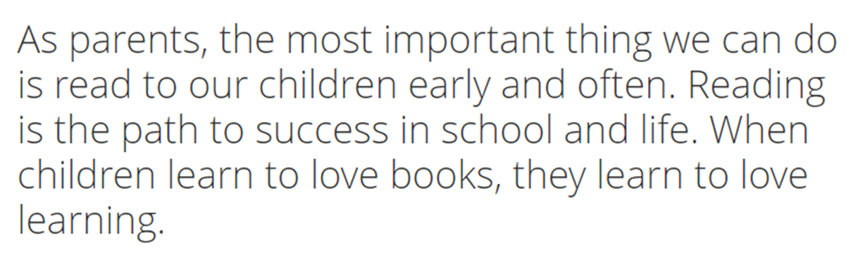

Slide 8
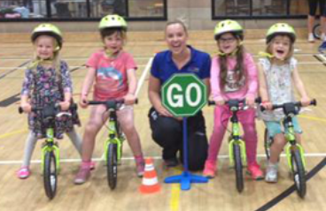
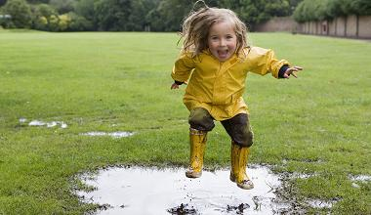



Please make sure your children are prepared for any eventualities!
Learning takes place indoors and outdoors
Forest school sessions
Weekly P.E
Balanceability
Warm clothes including
gloves, hats etc
Wellies
Spare clothes
PE kit
Sun cream
Hat
Spare clothes
PLEASE NAME EVERYTHING!

Slide 9



Attendance
Reception - 8:40am – 3.20pm
Arrive on time as being punctual helps to establish routines
Being late means missed learning opportunities
Telephone the school as early as possible if your child will not be in school.
Please avoid being late when collecting your child as you could be charged - £5 per 5 minutes.
Attendance is vital for children’s learning!
  95% attendance = 9 missed days
  90% attendance = 18 missed days
  85% attendance = 27 missed days
  Half termly attendance letters sent to parents

Slide 10


Communication Systems
You can leave messages for your child’s class teacher by calling the office on 0121 552 5491,
emailing contact.us@stjamespri.uk
Arbor – an app that can be downloaded to
your phone. This is the platform that we use for registration, assessments, behaviour incidents and end of year reports.
Parent Pay – as a cashless school all payments are made via parent pay.

Slide 11

Uniform
All children (Nursery – Year 6) need:
burgundy St James crew neck sweat shirt/ sweatshirt cardigan
white polo t-shirt or shirt
grey or black school trousers/skirt/pinafore dress
black flat sensible school shoes (shoes are to be plain with no coloured logos) EYFS-NO LACES
In warm weather girls may wear a red gingham dress and boys grey/black shorts
Optional burgundy St James zip fleece
PE kit-black bottoms, white T.shirt, black hoody or school cardigan/jumper. Trainers EYFS-NO LACES

Slide 12

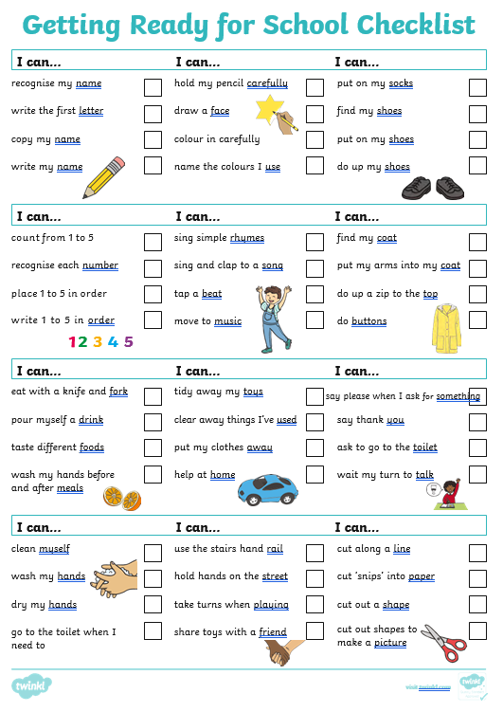


How can I support my child?

Slide 13

How can I support my child?
Read daily with your child – this fosters a love for reading which will support your child throughout their school life
Write their name independently – lower case letters
Number and letter recognition
Hearing beginning sounds in words
Writing numbers and letters
Counting objects using one to one correspondence
School reading book – when blending letters.
Class Email receptionclass@stjamespri.uk (photos only)
Let us know any significant learning – WOW moments.
Send photos of interesting events/activities for your child to talk about with the class.

Slide 14


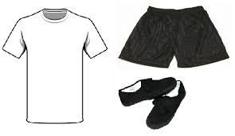
Things to remember…
What your child needs when starting Reception….
Name labels on all clothing items please!
Spare clothes (1 set to be left on peg in a named carrier bag or small rucksack)
Water bottle (Appropriate size)
Any outstanding Registration Documents given to the office before they start school
Your child will receive a free school book bag when starting school so you don’t need
to purchase one.
Also…….
Keep us informed on any changes – address/telephone, children’s health and change in circumstances which may affect child.
Bumps / accidents – You will receive an email via Medical Tracker. School will call if needed.

Slide 15

IMPORTANT!
We are a nut free school.
We have children with severe nut allergies.
Anything sent in packed lunches that has nuts will be removed from children and given to parents at end of day. Please check ingredients before sending in.
Thank you for your support.

Slide 16

Thank you for visiting…..
Before you go ……
Hand in any registration forms you may have completed whilst here or drop them into school ASAP
Check that you are aware of the date & time for your child’s home visit (if applicable) and their start date / time.
Sign up to a ‘Stay and Play’ session on Friday 4th September.
If you have any questions, please come and ask us.

Slide 17
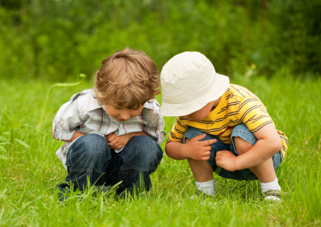
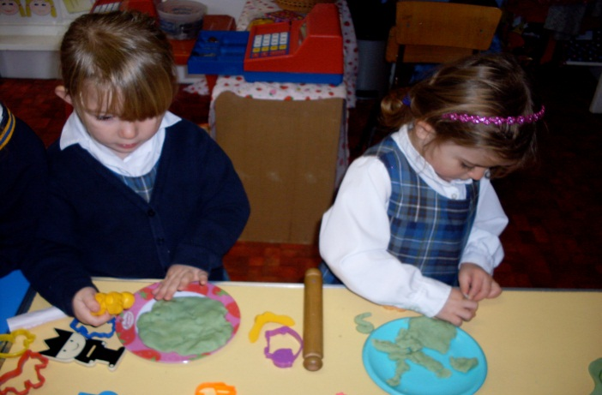
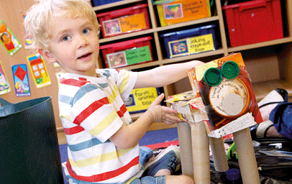

Thank you ….
Let the journey begin….

