Slide 1


Welcome to
St James C of E Primary School

Slide 2



Our School Vision and Values
Children are at the centre of everything that we do.
This is underpinned by our vision of
'Let us love...Let us thrive'
and core values of
love, friendship, respect, endurance,
honesty, peace.

Slide 3
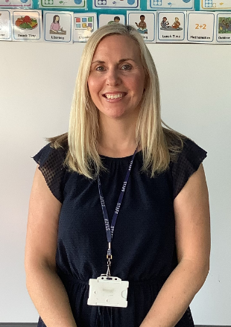
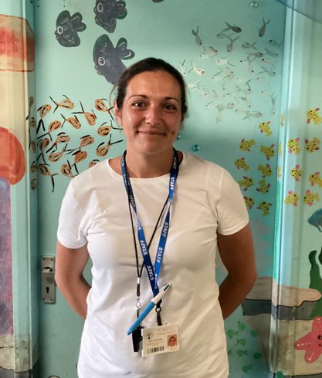
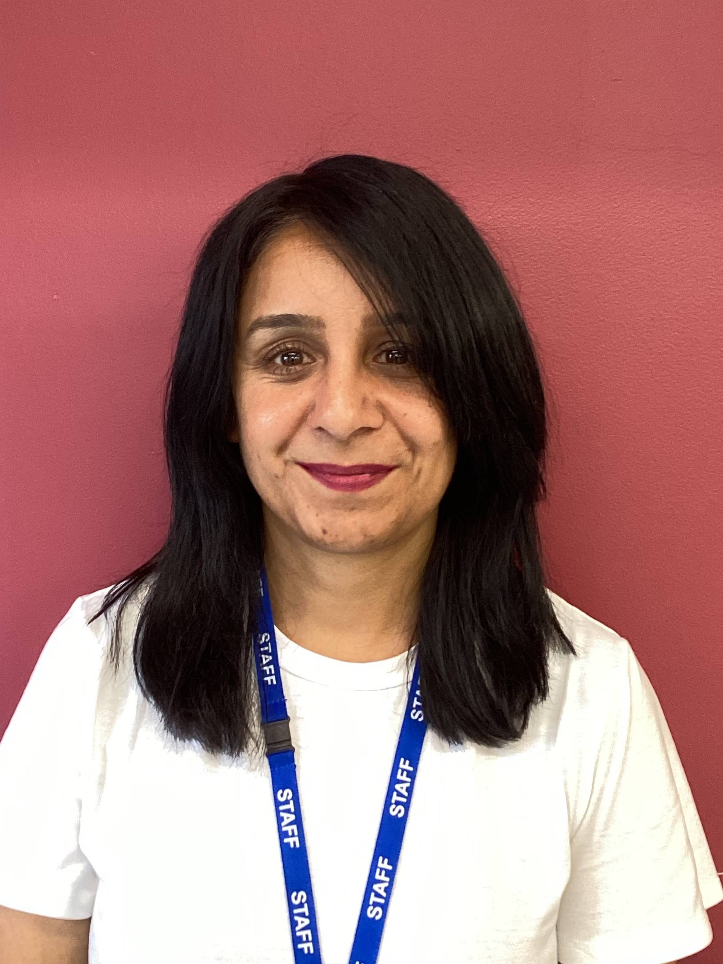


Meet the Nursery team…
Miss Melia Miss Arabzadeh Mrs Taak

Slide 4

Starting Nursery
Transition
Home visits-Wednesday 2nd and Thursday 3rd September
An informal opportunity for your child to meet their new teachers in the comfort of their own home.
Visits to school – Stay and Play Sessions
Friday 4th September – please sign up
You and your child visit the Nursery classroom and have the opportunity to meet other parents and children.
Individual start dates
Staggered over the first two weeks

Slide 5


Areas of Learning
Prime Areas of Learning
Personal, Social and Emotional – relationships, feelings, self confidence, independence
Physical Development – pencil control, using scissors, self care, keeping healthy, forest school, running/skipping
Communication and Language – Listening, understanding and speaking
Specific Areas
Literacy – reading and writing
Mathematics – numbers, shape, space and measures
Understanding the World –people and communities, the world, technology
Expressive Arts and Design – exploring media, being imaginative
Mixture of child initiated and adult led learning

Slide 6
Our Daily Routine (Autumn Term)
AM Nursery
9.00 – Arrive at Nursery, registration
9.10 – Circle time in family groups
9.20 – ‘Choosing time’
9.55 – Phonics oral blending games
10.00 - Snack time
10.20 – Number time
10.30 – Outside Play / ‘Choosing time’
11.20 – Storytime
11.45 – Lunch (for full day)
12.00 – Home time (for AM children)
PM Nursery
12.20 – Arrive at Nursery, registration
1230– Outside Play
1.00 –Circle time in family groups
1.15 Phonics oral blending games
1.20 – ‘Choosing time’
2.00-Snacktime
2.20-Number time
2.30-Outside Play/‘Choosing time’
3.00 – Storytime
3.20 – Home time

Slide 7



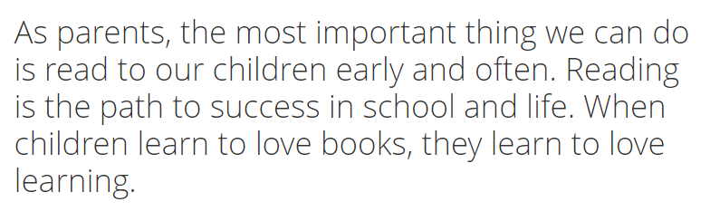

Slide 8

The rest of the team….Parents
Parents and school work together throughout your child’s learning journey…..
Please share your child’s interests, talents, abilities with your child’s teacher / keyworker. This enables us to tailor the curriculum to meet your child’s needs and plan lessons that will be exciting and engaging for your child.
Throughout the year you can reinforce the skills your child is developing – therefore helping to consolidate learning.

Slide 9

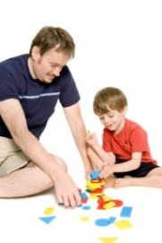


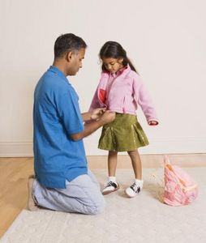
How can I support my child?
Nursery
Before starting Nursery……
Share stories, talk about the illustrations
Put shoes/wellies, coats and jumpers on independently
Use the toilet independently
During their Nursery year……
Talk about what we did at school
Support to recognise and write their name
Email nursery@stjamespri.uk
Let us know any significant learning – WOW moments.
Send photos of interesting events/activities for your child to talk about with the class.

Slide 10

Uniform
All children (Nursery – Year 6) need:
burgundy St James crew neck sweat shirt/ sweatshirt cardigan
white polo t-shirt or shirt
grey or black school trousers/skirt/pinafore dress
black flat sensible school shoes (shoes are to be plain with no coloured logos) EYFS-NO LACES
In warm weather girls may wear a red gingham dress and boys grey/black shorts
Optional burgundy St James zip fleece
PE kit-black bottoms, white T.shirt, black hoody or school cardigan/jumper. Trainers EYFS-NO LACES

Slide 11

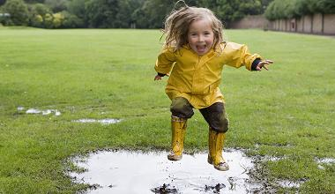


Learning takes place indoors and outdoors
Please make sure your children are prepared for any eventualities!
Warm clothes including
gloves, hats etc
Wellies
Spare clothes
Sun cream
Hat
Spare clothes
PLEASE NAME EVERYTHING!

Slide 12

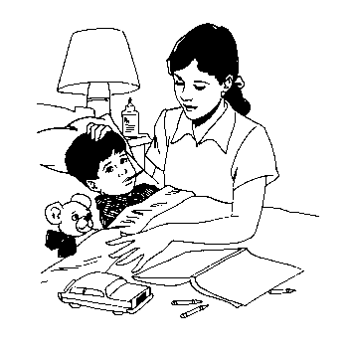

Attendance
Nursery – 9.00am-12pm / 12:20pm -3:20pm
Arrive on time as being punctual helps to establish routines
Being late means missed learning opportunities
Telephone the school as early as possible if your child will not be in school.
Please avoid being late when collecting your child as this causes upset and there will be a charge of £5 per 5 minutes.

Slide 13


Communication Systems
You can leave messages for your child’s class teacher by calling the office on 0121 552 5491,
emailing contact.us@stjamespri.uk.
Arbor – an app that can be downloaded to your phone. This is the platform that we use for registration, assessments, behaviour incidents and end of year reports.
Parent Pay – as a cashless school all payments are made via parent pay.

Slide 14


Things to remember…
What will your child need when starting Nursery?
Name labels on all clothing items!!!!
Spare clothes – accidents happen!
Registration Documents given to the office
Water bottles (name on and a suitable size)
Full day sessions include eating at school.
Children who attend a full day must bring
a healthy packed lunch in a labelled lunch box
Keep us informed of any changes – address/telephone, children’s health and changes in circumstances which may affect child.
Bumps / accidents – You will receive an email via Medical Tracker. School will call if needed.

Slide 15

IMPORTANT!
We are a nut free school.
We have children with severe nut allergies.
Anything sent in packed lunches that has nuts will be removed from children and given to parents at end of day. Please check ingredients before sending in.
Thank you for your support.

Slide 16
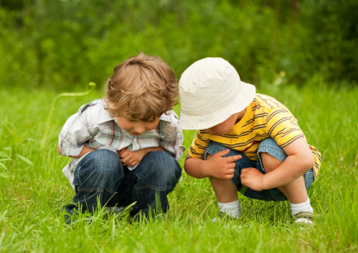
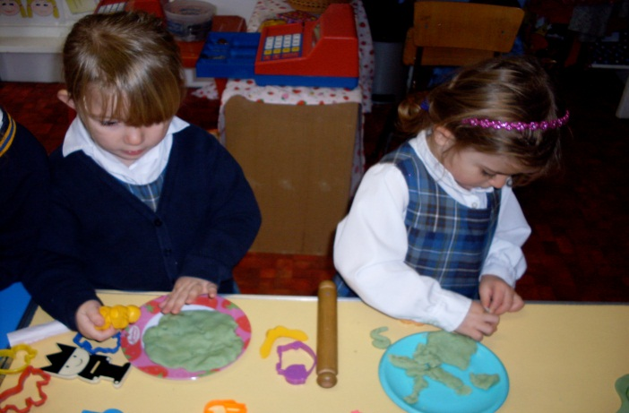
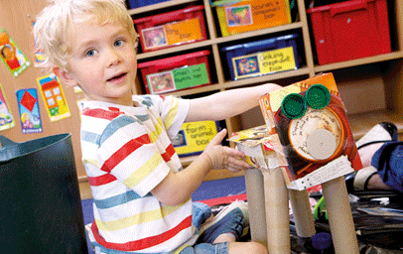

Thank you ….
Let the journey begin….

