Slide 1
Understanding the Multiplication Tables Check
Notes:
Purpose and Overview of the MTC, Structure and Timing of the MTC Assessment, Supporting Children’s Confidence and Preparation at Home

Slide 2

Purpose and Overview of the MTC
Assessment Purpose
The MTC ensures Year 4 pupils recall multiplication facts fluently up to 12 × 12
Test Format
The check is delivered digitally with randomly generated questions in a controlled environment to ensure fairness.
Support and Benefits
MTC builds confidence, identifies pupils needing support, and promotes positive learning habits for families and teachers.
Consistency in Education
The MTC promotes consistent assessment across schools, helping tailor teaching and track pupil progress effectively.
Notes:
The Multiplication Tables Check (MTC) is a statutory assessment introduced to ensure that pupils in Year 4 have a strong and fluent recall of multiplication facts up to 12 × 12. This assessment forms an essential part of mathematics education because instant retrieval of multiplication facts supports the development of more complex problem‑solving skills in later years. The MTC is delivered digitally, meaning children complete the check on a computer or tablet in a controlled environment. The system generates a set of multiplication questions at random, ensuring that the assessment is both fair and comprehensive. In addition to academic benefits, the MTC encourages pupils to build confidence and speed in recalling facts that they will rely upon throughout Key Stage 2 and beyond. Many children find multiplication tables challenging to memorise, and the check provides valuable information to teachers and parents about which pupils may need additional support. Furthermore, the introduction of the MTC helps ensure consistency across all schools in assessing table fluency, allowing teachers to identify trends and tailor their teaching accordingly. This is especially important given the wide range of mathematical topics that require instant recall of these fundamental facts. The MTC is not designed to cause stress for children; rather, it aims to reinforce positive learning habits and highlight progress. Parents can help reinforce these facts at home by incorporating short, regular practice sessions and engaging activities. Understanding the purpose and format of the MTC allows families to better support their children, creating opportunities for learning that seamlessly integrate into daily routines. With consistent practice and encouragement, children can build strong mathematical foundations that will benefit them for years to come.

Slide 3
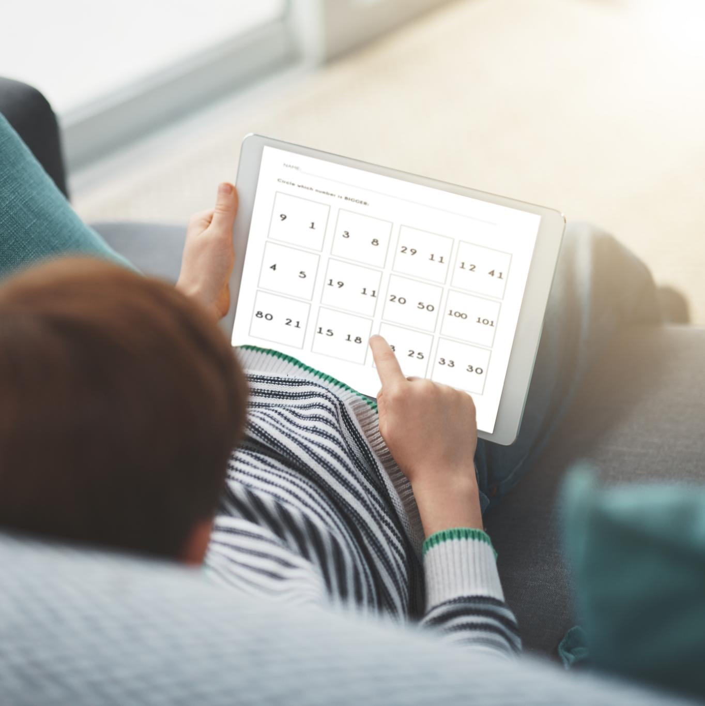
Structure and Timing of the MTC Assessment
Assessment Format and Timing
The MTC has 25 random multiplication questions up to 12x12, each answered within six seconds with a three-second pause.
Digital Platform and Accessibility
The test is taken on tablets showing one question at a time to support ease of use.
Preparation and Familiarity
Practice sessions help children reduce anxiety and become familiar with the digital format and test pace.
Purpose and Outcomes
The MTC measures automatic recall speed and accuracy to identify pupils needing additional multiplication fluency support.
Notes:
The Multiplication Tables Check consists of 25 questions drawn randomly from the full range of multiplication facts up to 12 × 12. Each question must be answered within a strict six‑second time limit, with a three‑second pause between questions. This fast‑paced design aims to measure automatic recall rather than working‑out strategies. The assessment is taken on a digital device such as a tablet or laptop, and schools typically complete the check during a designated window in June. The system is adaptive only in terms of randomisation; difficulty remains consistent as the MTC includes only multiplication facts, not division or mixed operations. Children usually complete a few practice sessions beforehand to familiarise themselves with the digital format, reducing anxiety and ensuring equitable access for pupils with different levels of digital familiarity. The MTC interface is deliberately simple, displaying one question at a time with a clear input box. Most pupils complete the full check in under five minutes, making it one of the shortest statutory assessments in primary education. While speed is a component, accuracy is the main objective, and the system automatically records and scores each response. Schools receive results to help identify pupils who may benefit from targeted multiplication fluency support. Understanding the structure helps parents guide home practice effectively—short, timed bursts mimic the assessment conditions and support the development of automaticity. Many pupils find that regular exposure to timed questions increases both confidence and familiarity with the pace, making the assessment feel more approachable when the time arrives.

Slide 4
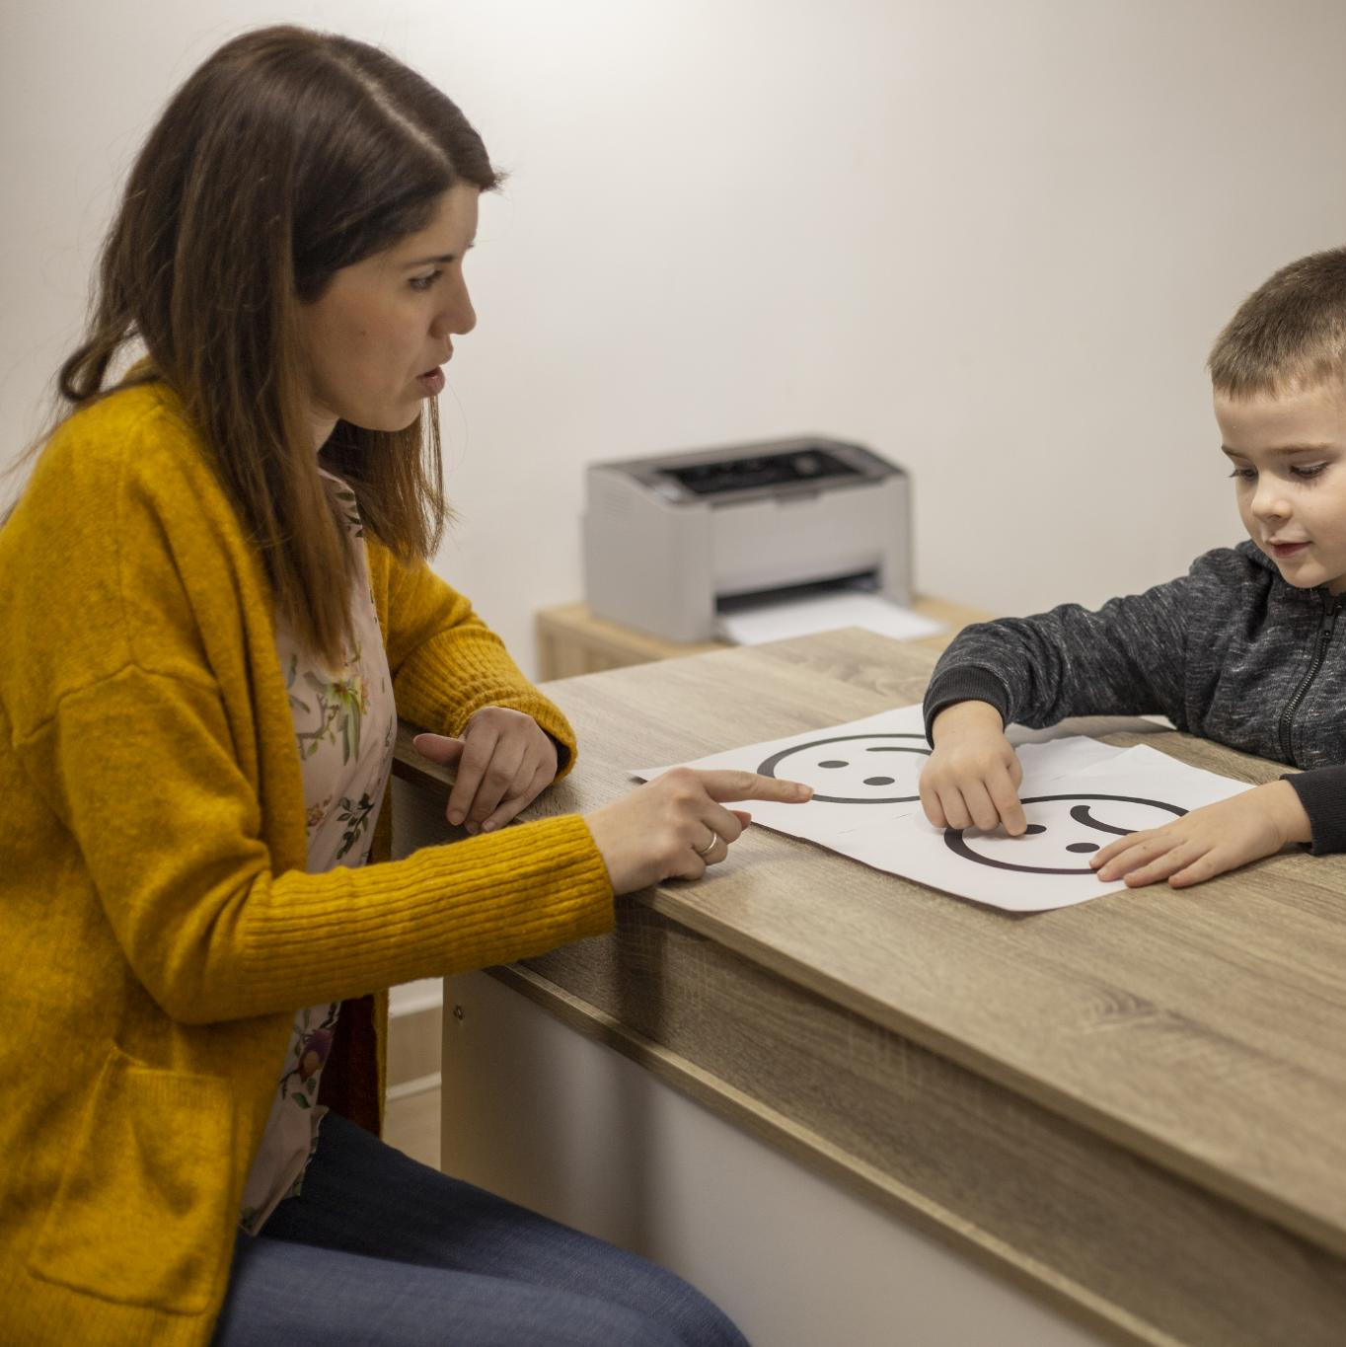
Supporting Children’s Confidence and Preparation at Home
Consistent Small Practice
Frequent short practice sessions are more effective than longer, infrequent ones for rapid recall development.
Use of Everyday Opportunities
Incorporate multiplication questions during daily activities like car journeys or meal preparation.
Digital and Traditional Tools
Interactive games, flashcards, chants, and songs motivate children and enhance memory through repetition – ttrs, timestable.co.uk, purple mash – multiplication, hit the button
Notes:
Parents play a crucial role in helping children prepare confidently for the MTC by creating a supportive and consistent practice environment. Research shows that small, frequent practice sessions are far more effective than longer, infrequent ones, and this approach mirrors the rapid‑recall focus of the check itself. A good starting point is to ensure children are secure in the easier multiplication facts before moving on to more challenging tables such as the 6s, 7s, 8s, and 12s. Parents can use everyday opportunities to reinforce table facts, such as incorporating quick recall questions during car journeys or while preparing meals. Many online platforms, such as interactive times‑table games and quizzing tools, can help motivate children by gamifying the experience. These tools often provide instant feedback, allowing children to track their improvement over time. In addition to digital activities, parents can support learning with traditional methods such as flashcards, chant‑based recall, and multiplication songs that enhance memory through rhythm and repetition. It is equally important to maintain a calm and encouraging atmosphere around practice sessions. Children benefit from positive reinforcement, particularly when learning something that requires memorisation and speed. Parents should celebrate progress—however small—and avoid creating pressure or comparison with peers. Building confidence also involves helping children manage the timed element of the check; using a simple stopwatch can help normalise the pacing without inducing stress. Structuring practice to include both accuracy‑focused tasks and speed‑based challenges can help children achieve a healthy balance. Above all, collaboration between home and school ensures children feel supported, capable, and prepared for the assessment.

