Slide 1

St James CE Primary School
Year 6

Slide 2
Welcome to Year 6
Miss Manning (6M)
Miss Kang
(6K)
Mrs Hey
HLTA
Mrs Ball
Miss Oddy
Mrs Barber
(teaches 6M on a Thursday)
Mr Stokes
Sports Coach/HLTA
Phase leader: Mrs Thomas
Assistant Headteacher: Mrs Zmitrowicz and Miss Manning
Deputy Headteacher: Mrs Dearn
Headteacher: Mr Heather

Slide 3

Our School Vision and Values
Children are at the centre of everything that we do.
This is underpinned by our vision of
'Let us love...Let us thrive’
and core values of love, friendship, respect, endurance, honesty, peace.

Slide 4


Slide 5
Lines of Communication
Class
Teacher
Phase Leader
Assistant Head/
Deputy Head
Head Teacher
You can leave messages for your child’s class teacher by calling the office on 0121 552 5491,
emailing contact.us@stjamespri.uk or messaging on the Arbor App. We aim to respond to communications within 5 working days.

Slide 6
School Website
The school website is up-to-date with all of the information that you need:
School diary (found on the school’s home page or under the parent information tab)
Year group information (found under the year groups tab)
Uniform expectations
School policies
Curriculum information
Our Christian vision and values
SEND information

Slide 7
School Website
An email will be sent regarding important information linked to your child and then this information will be shared on our school website.
It is imperative that you keep up to date with the school website and continue to check your emails (including your junk and spam folders).
Note: you will not receive multiple emails reminding you of upcoming events or deadlines.

Slide 8
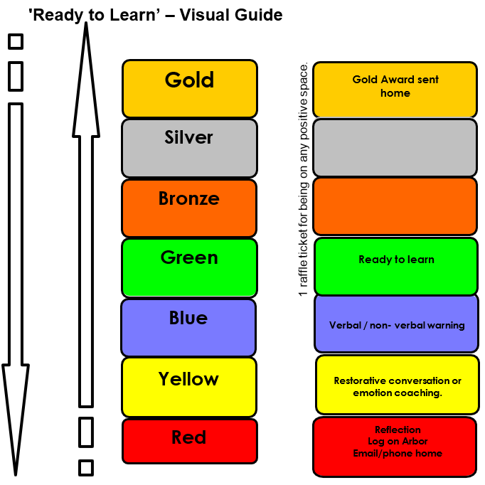
Ready to Learn Behaviour System
Between each stage, children are given opportunities to change their behaviour. A range of positive behaviour management strategies, including warnings or reminders will be given before a consequence.
Children will be given the opportunity to move from the negative consequence stage back to the positive – back to green and above.
If your child receives reflection time, you will be notified via email and can speak to staff at the end of the school day.

Slide 9
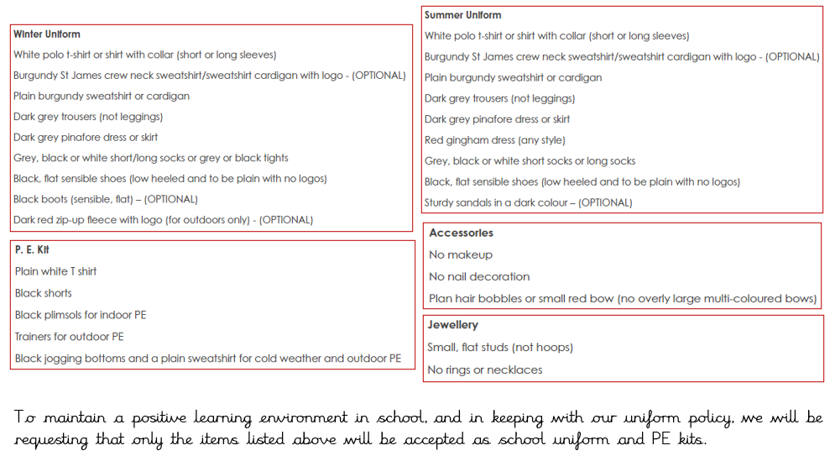
Uniform

Slide 10
Homework
Reading daily.
TTRockstars 3 times a week
A list of 10 spellings each week to be tested every Friday
School value creative project
A short Maths and SPaG activity linked to the week’s learning
Towards the start of SATs, children will be set LBQ (online) homework to complete.

Slide 11
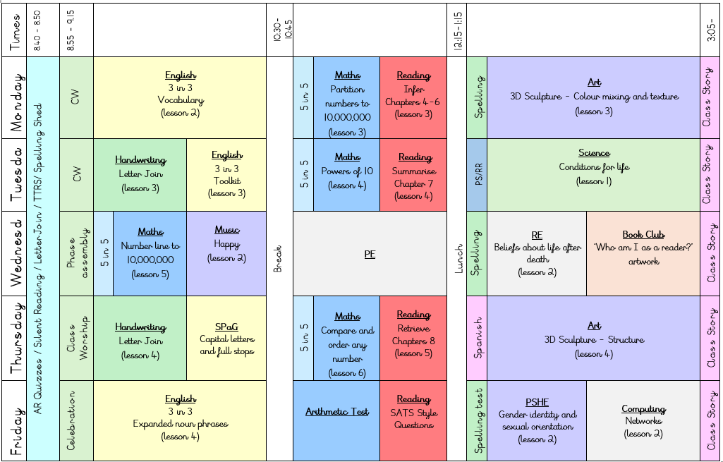
Our Daily Routine

Slide 12

TTRockstars
TTRockstars sessions in school and at home
Improved knowledge of times tables, helps with every day mathematics lessons.
Notes:
Delete if in Nursery, Reception and Y1.

Slide 13
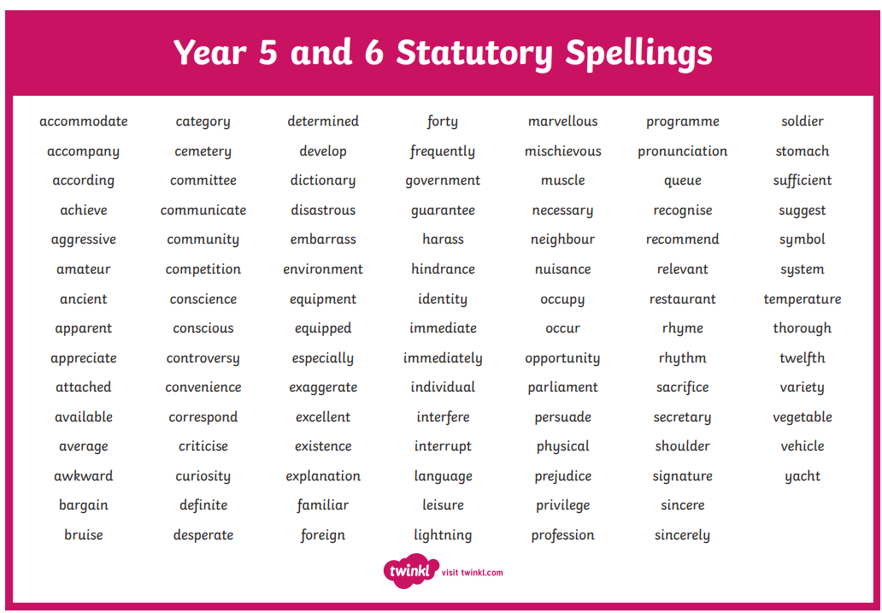
Spellings
Year 5/6 Statutory Spellings
Ed Shed – Spelling Shed

Slide 14





Reading
Expectation that children are reading daily at home – can be shared with an adult or independently

Slide 15
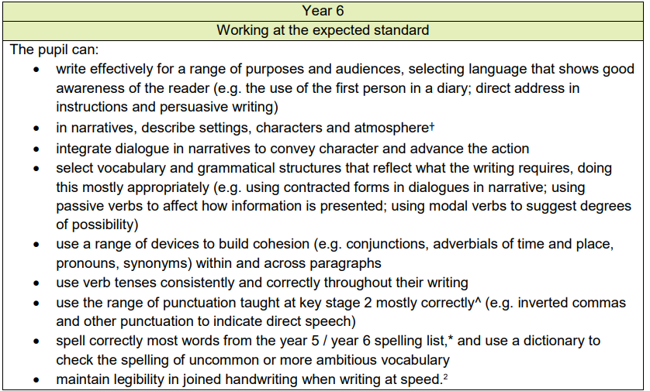
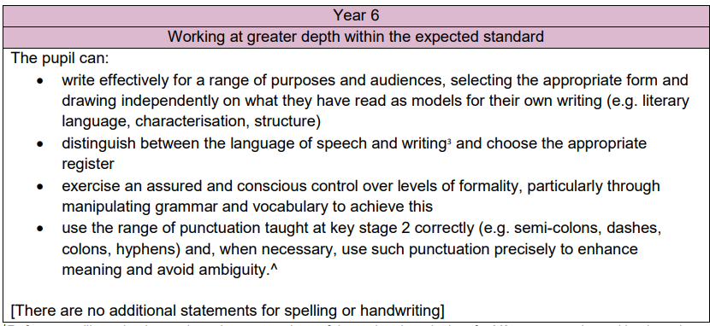
Writing

Slide 16
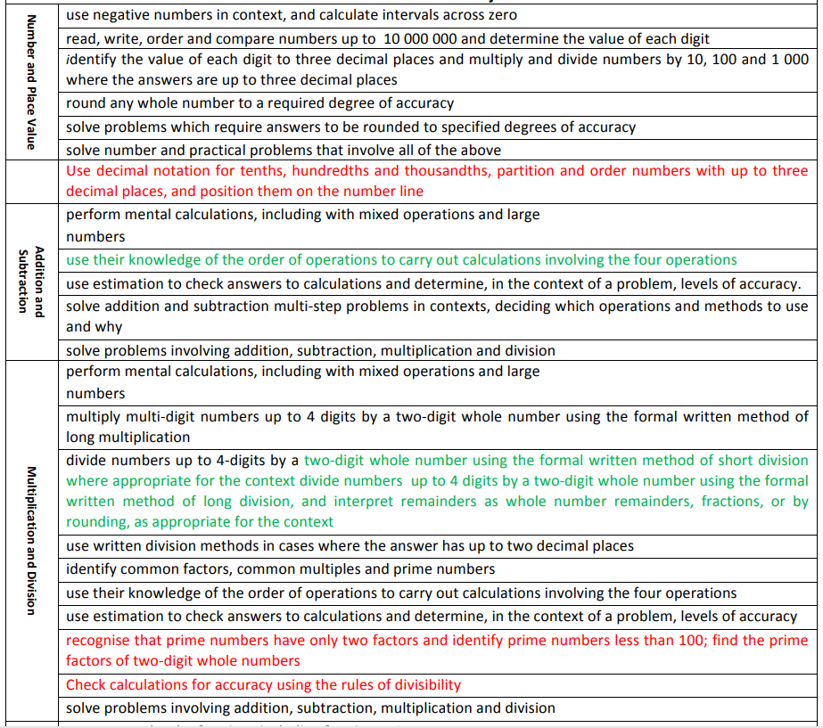
Maths

Slide 17
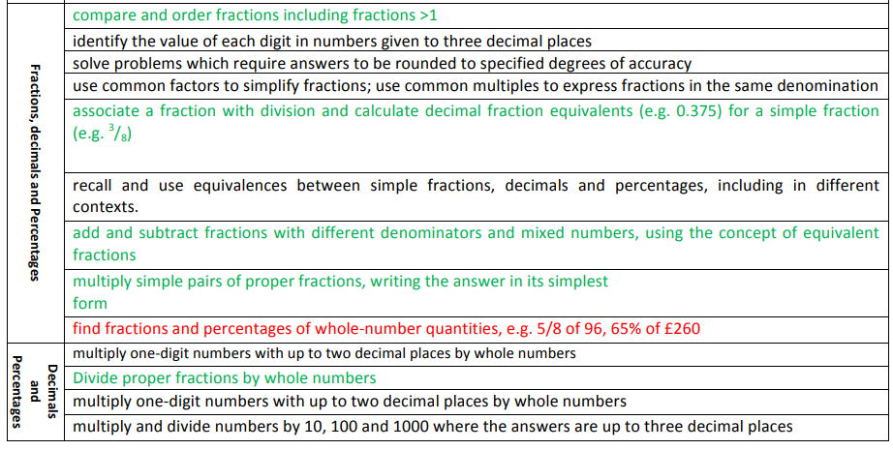
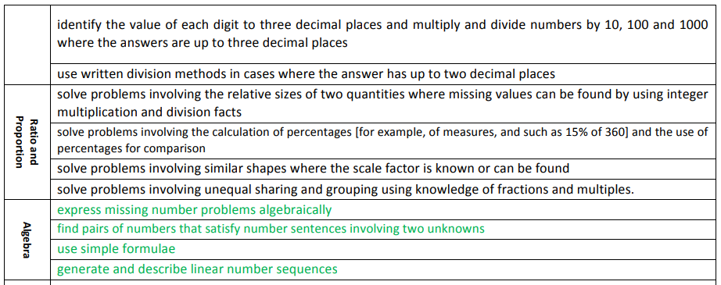
Maths

Slide 18
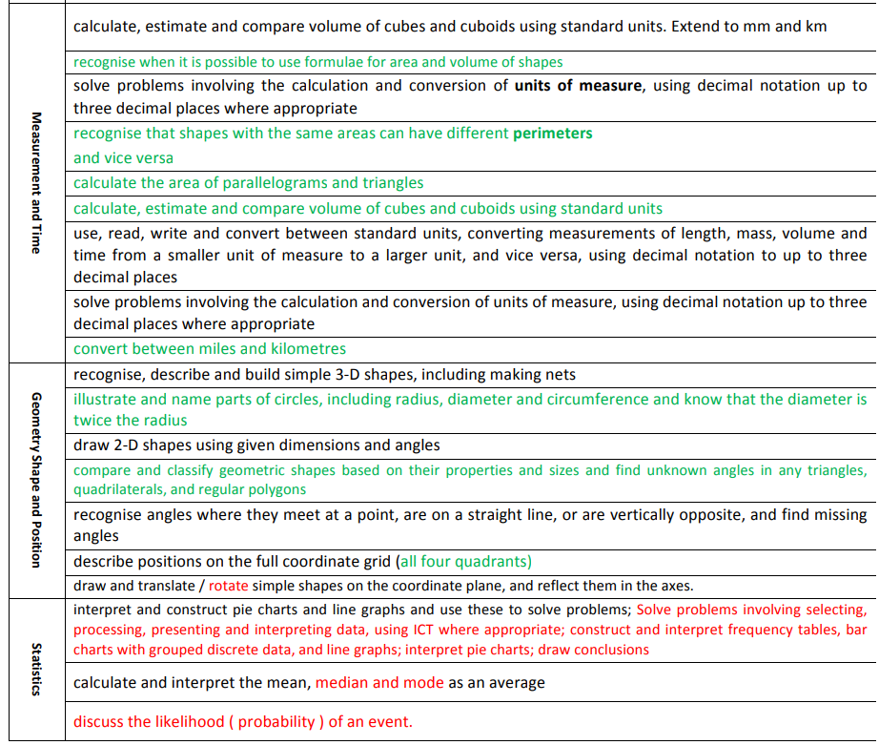
Maths

Slide 19
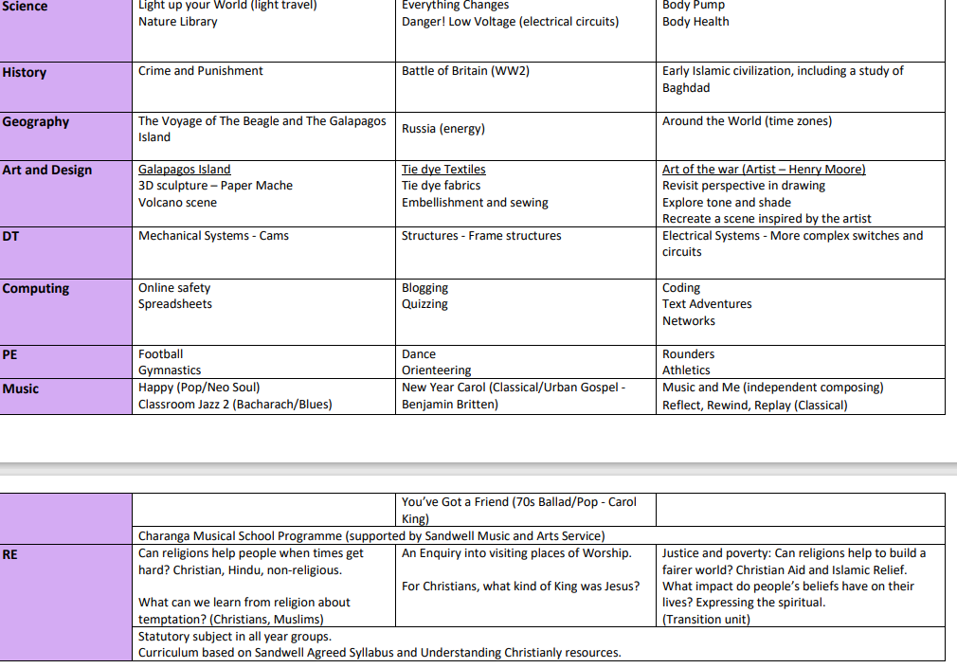
Year overview

Slide 20
Additional Information
Year 6 will have PE every Wednesday
Mrs Barber will cover 6M every Thursday
Celebration Assembly will be on a Friday morning at 9am (invited in by email).
Forest school – added to the school diary/website when dates are booked
Mobile phones – school and safety
Walk to school
High school choices – deadline 31st October 2025

Slide 21
SATs
SATs are the standardised assessment tests administered by primary schools in England to children in Year 6 to check their educational progress.​
Children will sit papers in:​
Reading​
SPaG (Spelling, Punctuation and Grammar)​
Maths (arithmetic paper and two reasoning papers)​
The SATS will take place from Monday 11th May 2026 – Thursday 14th May 2026.​
Additional information regarding the tests will be shared in more detail in the spring term. ​
Notes:
Delete if not Y6.

Slide 22
Thank you for attending today! Questions?

