Slide 1

St James CE Primary School
Year 3

Slide 2
Welcome to Year 3
Mrs Veal-Clarke
Miss B
Mrs Hey
HLTA
Mrs Lindsay
Mrs Hargun
Mr Stokes
Sports Coach/HLTA
Phase leader: Miss Merryweather
Assistant Headteacher: Mrs Zmitrowicz and Miss Manning
Deputy Headteacher: Mrs Dearn
Headteacher: Mr Heather

Slide 3

Our School Vision and Values
Children are at the centre of everything that we do.
This is underpinned by our vision of
'Let us love...Let us thrive’
and core values of love, friendship, respect, endurance, honesty, peace.

Slide 4


Slide 5
Lines of Communication
Class
Teacher
Phase Leader
Deputy Head
Head Teacher
You can leave messages for your child’s class teacher by calling the office on 0121 552 5491,
emailing contact.us@stjamespri.uk or messaging on the Arbor App. We aim to respond to communications within 5 working days.

Slide 6
School Website
The school website is up-to-date with all of the information that you need:
School diary (found on the school’s home page or under the parent information tab)
Year group information (found under the year groups tab)
Uniform expectations
School policies
Curriculum information
Our Christian vision and values
SEND information

Slide 7
School Website
An email will be sent regarding important information linked to your child and then this information will be shared on our school website.
It is imperative that you keep up to date with the school website and continue to check your emails (including your junk and spam folders).
Note: you will not receive multiple emails reminding you of upcoming events or deadlines.

Slide 8
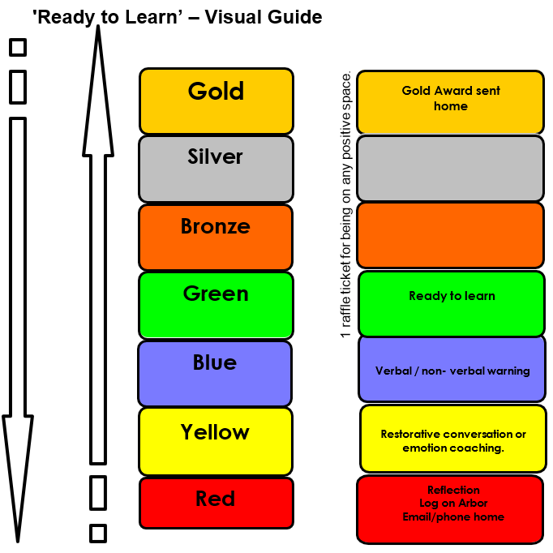
Ready to Learn Behaviour System
Between each stage, children are given opportunities to change their behaviour. A range of positive behaviour management strategies, including warnings or reminders will be given before a consequence.
Children will be given the opportunity to move from the negative consequence stage back to the positive – back to green and above.
If your child receives reflection time, you will be notified via email and can speak to staff at the end of the school day.

Slide 9
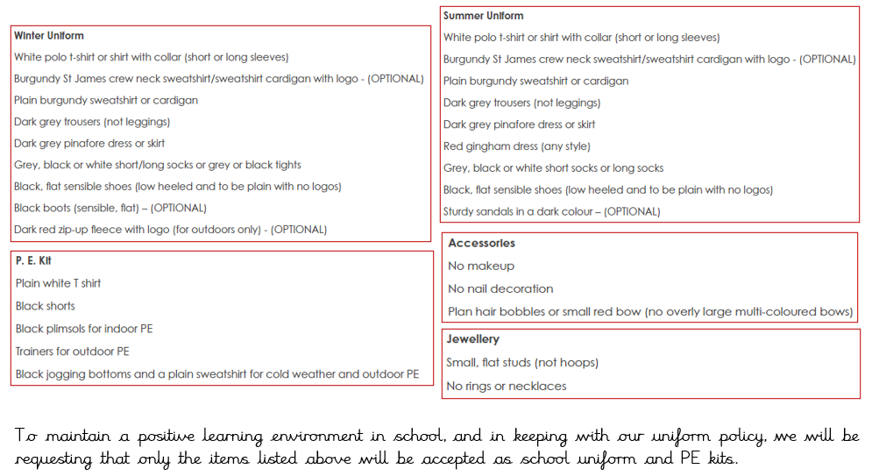
Uniform

Slide 10
Homework – Phase 3 and 4
Reading daily.
TTRockstars 3 times a week
Children may be given a specific activity linked to an area of the curriculum.
School value creative project
.

Slide 11
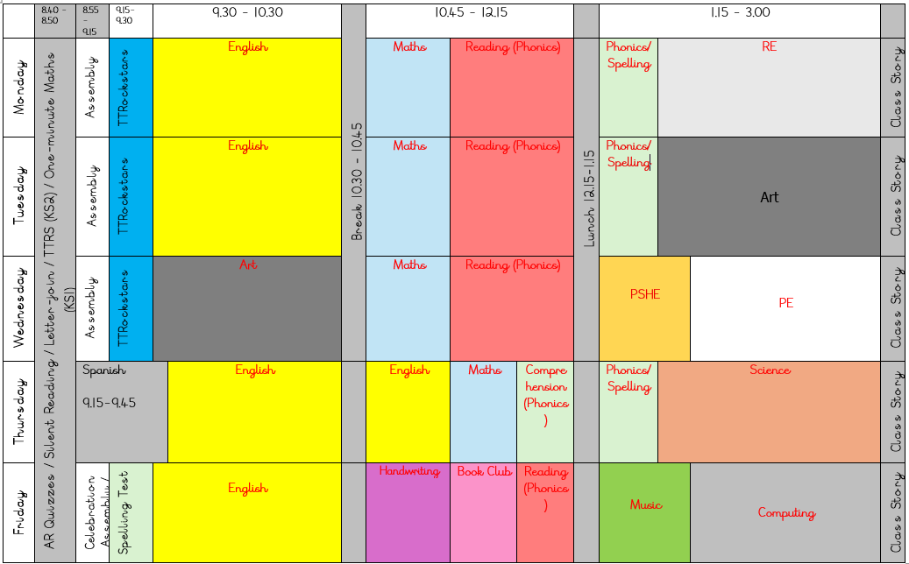
Our Daily Routine

Slide 12

TTRockstars
TTRockstars sessions in school and at home
Improved knowledge of times tables, helps with every day mathematics lessons.
Notes:
Delete if in Nursery, Reception and Y1.

Slide 13
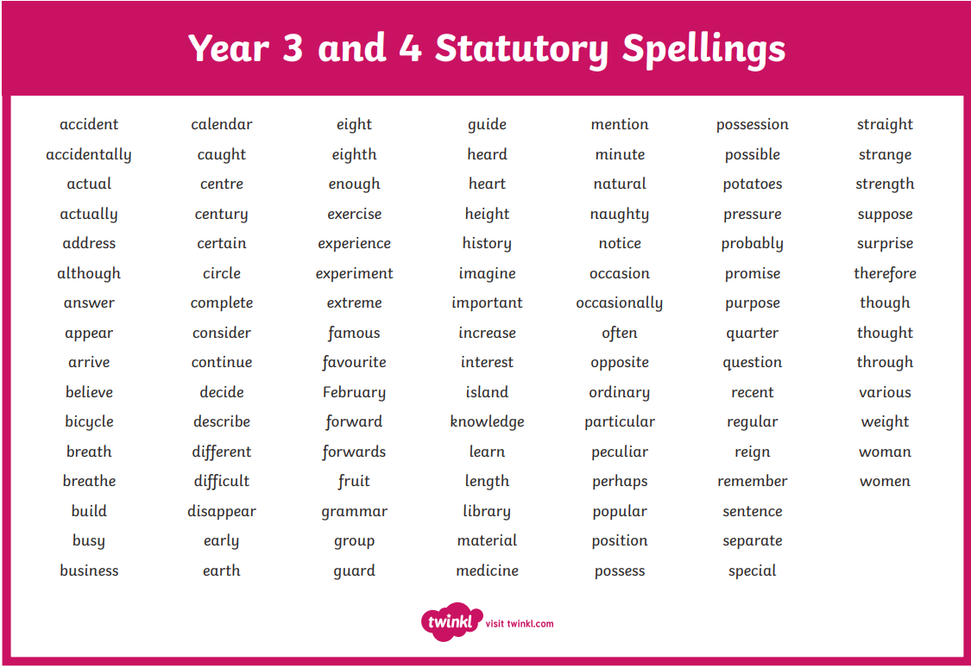
Spellings
Year 3 Statutory Spellings
Ed Shed – Spelling Shed

Slide 14







Reading
Autumn 1 | Autumn 2 | Spring 1 | Spring 2 | Summer 1 | Summer 2
Class Texts: The Sheep-Pig by Dick King Smith | Class Texts: The Boy Who Grew Dragons by Andy Shepherd | Class Text: Song of the Dolphin Boy | Class Text: George’s Marvellous Medicine | Class Text - The Firework Maker’s Daughter by Phillip Pullman | Class Text – Charlie and the Chocolate Factory by Roald Dahl
Home reading expectations

Slide 15
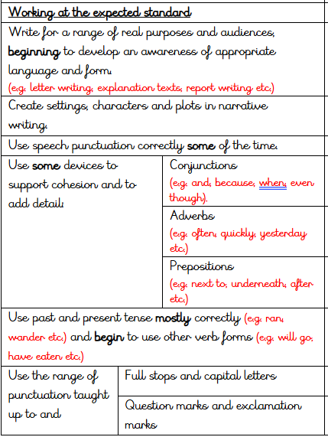
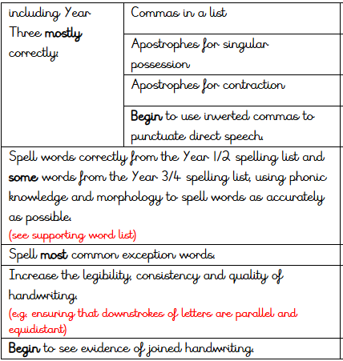
Writing

Slide 16
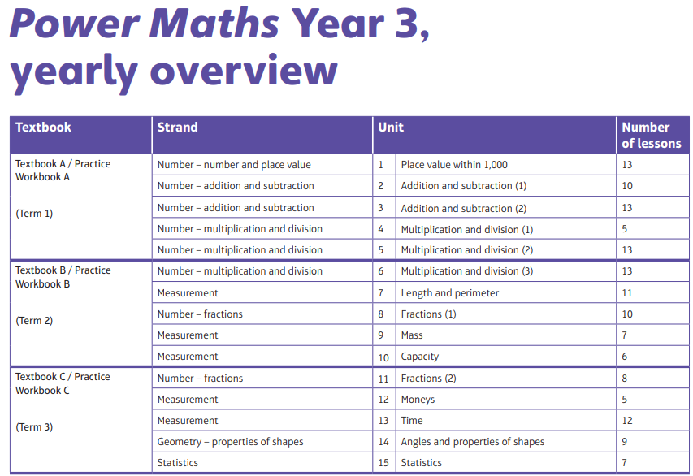
Maths

Slide 17
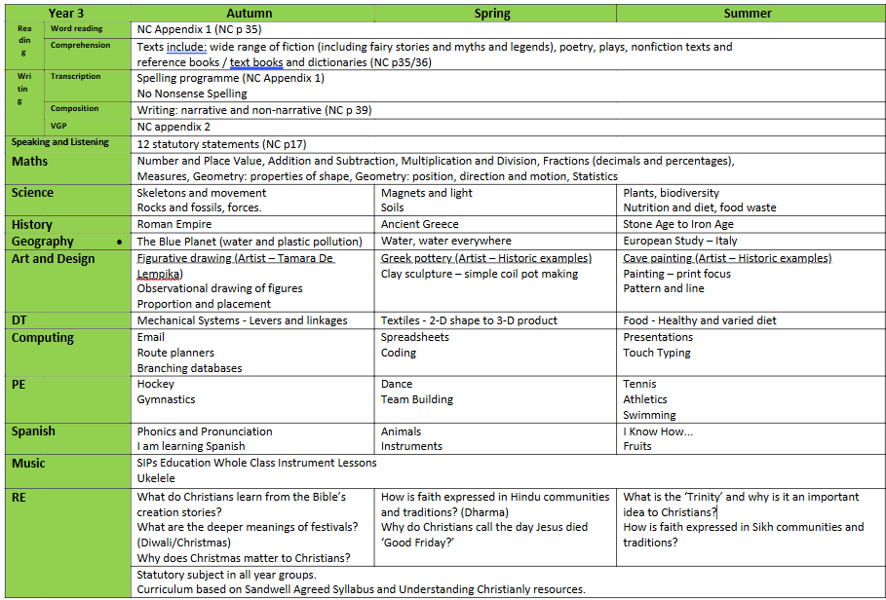
Year overview

Slide 18
Additional Information
PE day - Wednesday
Celebration Assembly will be on a Friday morning at 9am (invited in by email).

Slide 19
Thank you for attending today!
Questions?

