Slide 1

St James CE Primary School
Year 4

Slide 2
Welcome to Year 4
Teacher – Miss Merryweather
Teacher – Mrs Thomas and Mr Sanga (Wednesday)
Mrs Hey
HLTA
Support staff – Mrs Pailing and Mrs Fernandes
Support staff – Miss Oddy
Mr Stokes
Sports Coach/HLTA
Phase leader: Miss Merryweather
Assistant Headteacher: Mrs Zmitrowicz and Miss Manning
Deputy Headteacher: Mrs Dearn
Headteacher: Mr Heather

Slide 3

Our School Vision and Values
Children are at the centre of everything that we do.
This is underpinned by our vision of
'Let us love...Let us thrive’
and core values of love, friendship, respect, endurance, honesty, peace.

Slide 4


Slide 5
Lines of Communication
Class
Teacher
Phase Leader
Deputy Head
Head Teacher
You can leave messages for your child’s class teacher by calling the office on 0121 552 5491,
emailing contact.us@stjamespri.uk or messaging on the Arbor App. We aim to respond to communications within 5 working days.

Slide 6
School Website
The school website is up-to-date with all of the information that you need:
School diary (found on the school’s home page or under the parent information tab)
Year group information (found under the year groups tab)
Uniform expectations
School policies
Curriculum information
Our Christian vision and values
SEND information

Slide 7
School Website
An email will be sent regarding important information linked to your child and then this information will be shared on our school website.
It is imperative that you keep up to date with the school website and continue to check your emails (including your junk and spam folders).
Note: you will not receive multiple emails reminding you of upcoming events or deadlines.

Slide 8
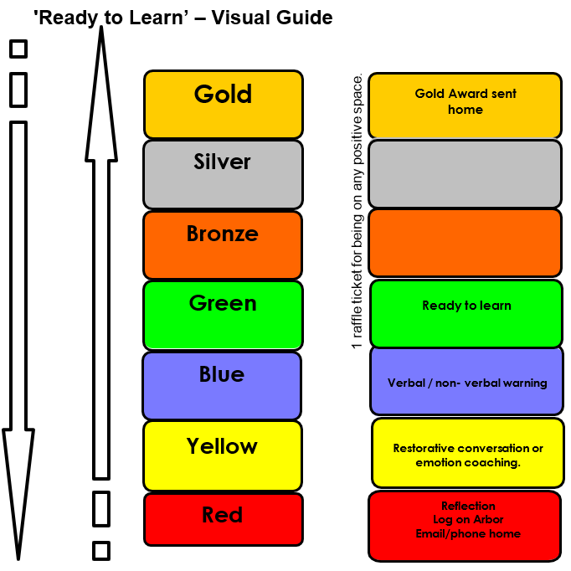
Ready to Learn Behaviour System
Between each stage, children are given opportunities to change their behaviour. A range of positive behaviour management strategies, including warnings or reminders will be given before a consequence.
Children will be given the opportunity to move from the negative consequence stage back to the positive – back to green and above.
If your child receives reflection time, you will be notified via email and can speak to staff at the end of the school day.

Slide 9
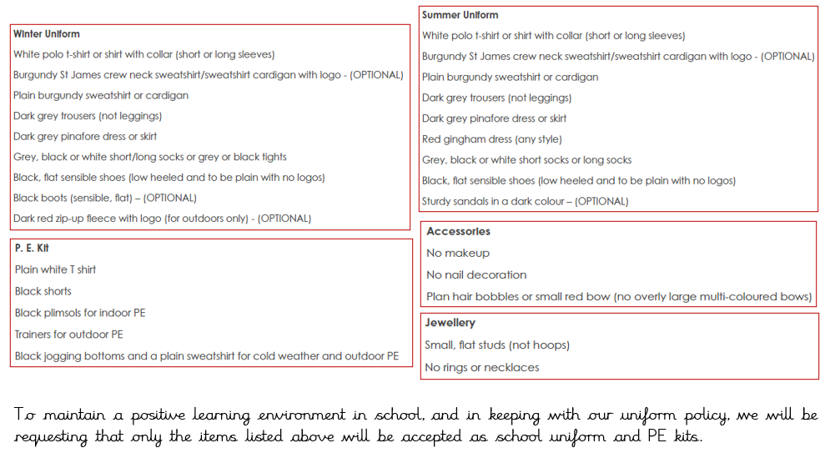
Uniform

Slide 10
Homework – Phase 3 / 4
Reading daily.
TTRockstars 3 times a week
Children may be given a specific activity linked to an area of the curriculum.
School value creative project – friendship autumn 1
.

Slide 11
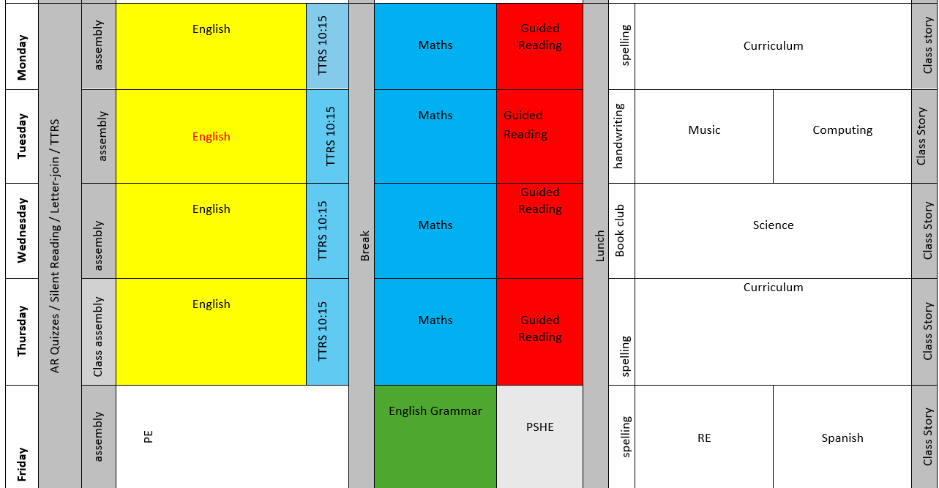
Our Daily Routine

Slide 12

TTRockstars
TTRockstars sessions in school and at home
Improved knowledge of times tables, helps with every day mathematics lessons.
Notes:
Delete if in Nursery, Reception and Y1.

Slide 13
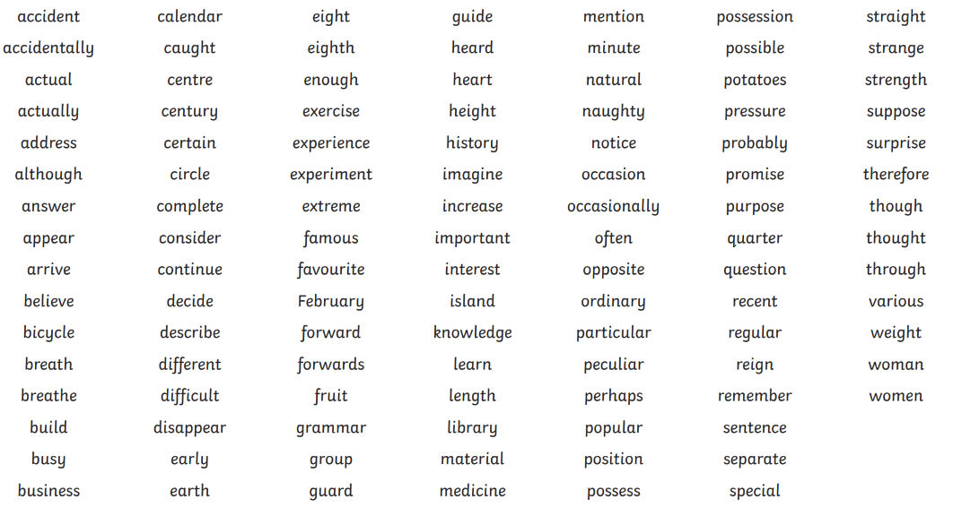
Spellings
Year 3/4 Statutory Spellings
Ed Shed – Spelling Shed

Slide 14



Reading
We will read in guided reading lessons:

Slide 15
Reading
Children have a reading book with a zpd number on the side.
The children should read at home daily their home reading book and encourage them to read other books for example books from the library.
Whether the children move up a level or not depends on them completing online questions about what they read to show they have understood what they read.

Slide 16
Writing
The pupil can:
write for a range of purposes and audiences with an increasing awareness of appropriate language and form create settings, characters and plot in narrative
use speech punctuation correctly most of the time
use vocabulary and grammatical structures to communicate ideas for the given audience and purpose (e.g. use a range of sentences and begin to vary the position of clauses within a sentence)
use a range of conjunctions, adverbs, prepositions and pronouns for cohesion, detail and clarity (e.g. appropriate noun or pronoun to avoid repetition and adverbs to express time and cause)
use past and present tenses correctly, and include a wider range of verb forms (e.g. we were going
use the range of punctuation taught up to and including Y4 mostly correctly (e.g. commas after adverbials; use of apostrophe)
spell correctly words from learning in previous year groups, and most words from the year 3 / year 4 spelling list, beginning to use a dictionary to check spellings
write legibly and with increasing fluency, paying attention to size and spacing
maintain the use of joined handwriting throughout independent writing.

Slide 17
Maths
Year 4 Maths expectations include:
mastering multiplication facts up to 12x12,
adding and subtracting numbers with up to 4 digits,
performing multiplication of 2- and 3-digit numbers by a 1-digit number,
understanding four-digit place value
ordering numbers beyond 1,000,
rounding to the nearest 10, 100, or 1,000,
reading Roman numerals to 100.
Additionally, pupils learn to work with fractions, measure, convert units of time, calculate perimeters, identify angles, and interpret data in charts.

Slide 18
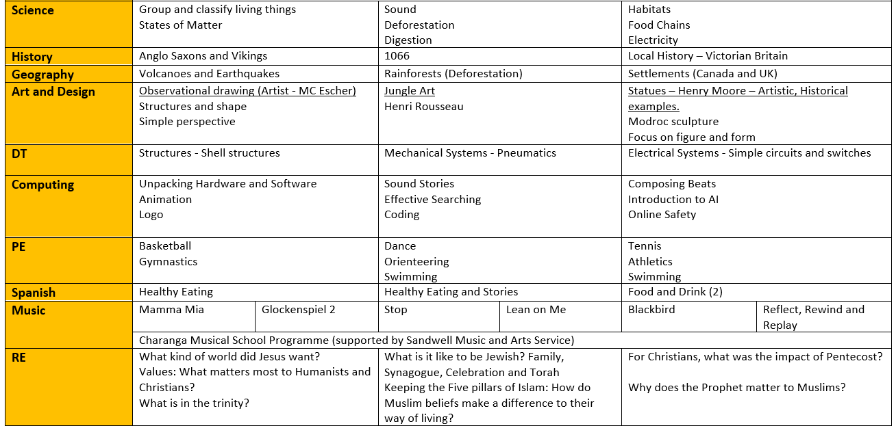
Year overview

Slide 19
Additional Information
PE day - Friday
Celebration Assembly will be on a Friday morning at 9am (invited in by email).
Values Assembly in church half termly again invited by email

Slide 20
Multiplication Times Table Check
The purpose of the check is to determine whether your child can fluently recall their times tables up to 12, which is essential for future success in mathematics.
It is an on-screen check consisting of 25 times table questions. Your child will be able to answer 3 practice questions before taking the actual check. They will then have 6 seconds to answer each question. On average, the check should take no longer than 5 minutes to complete.
The check will take place between Monday 1st and Friday 12th June.
Notes:
Delete if not Y4.

Slide 21
Thank you for attending today!
Questions?

