Slide 1


Slide 2


Slide 3

Time for the experts to explain…
https://www.youtube.com/watch?v=Kx7PCzg0CGE&t=25s

Slide 4
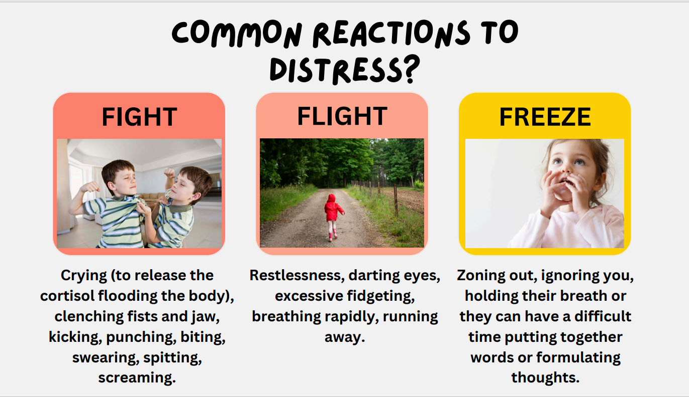

Slide 5
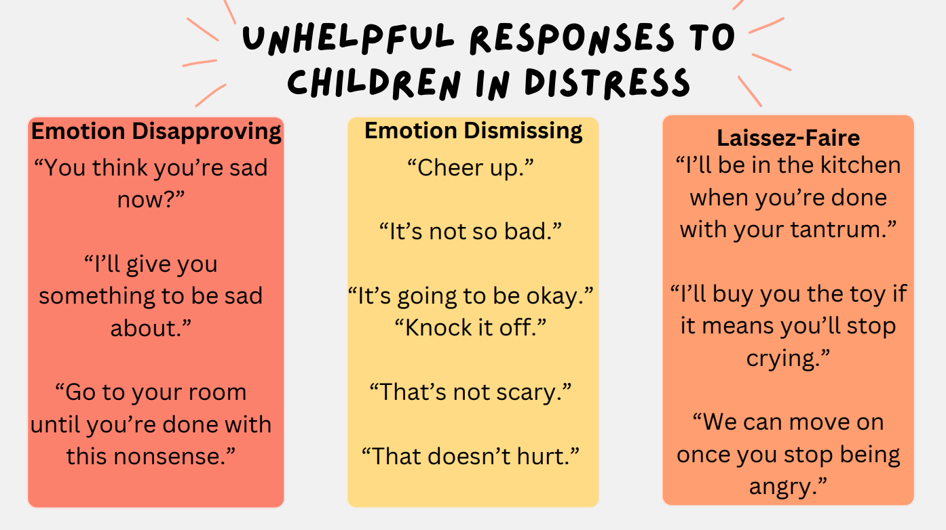

Slide 6
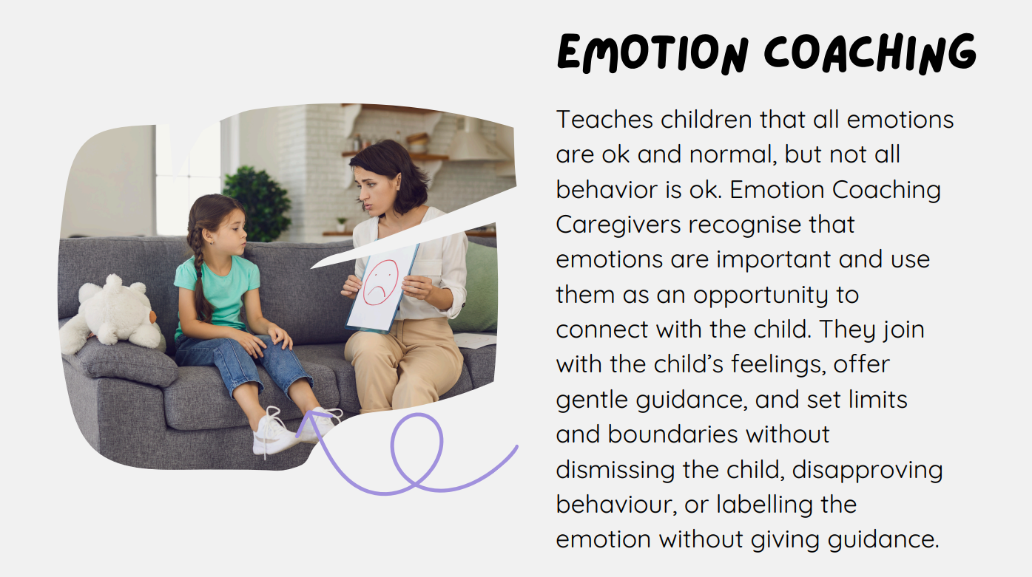

Slide 7


Slide 8
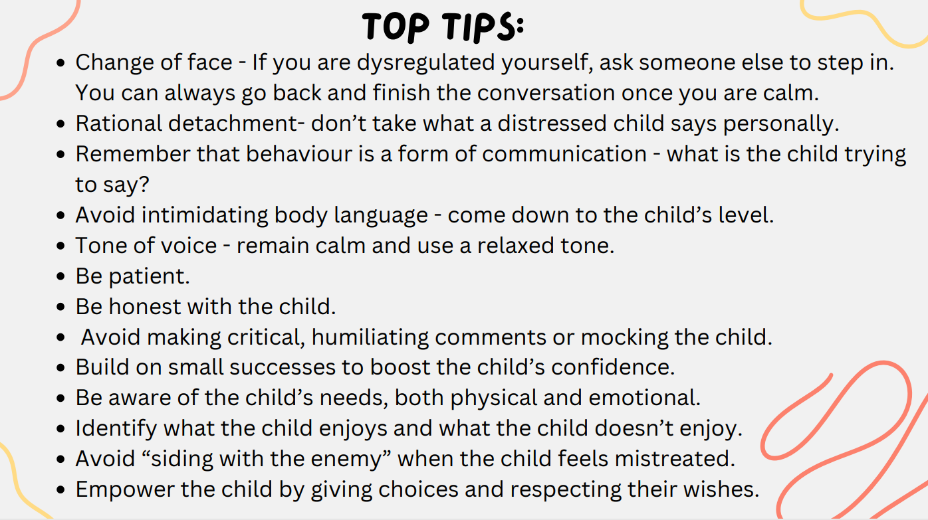

Slide 9
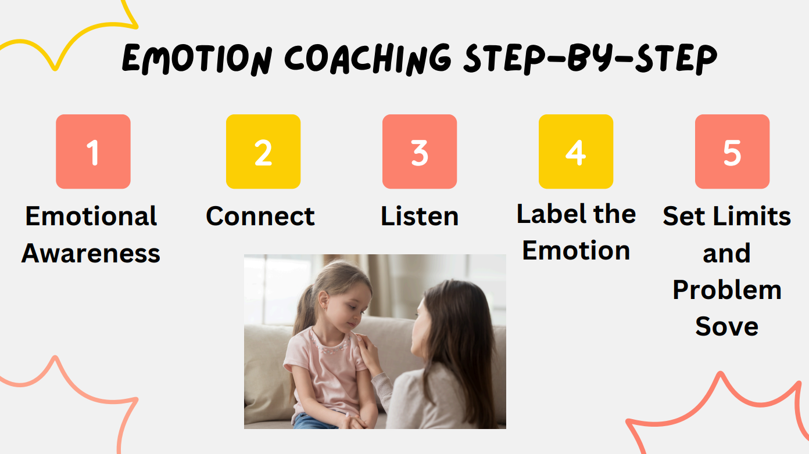

Slide 10
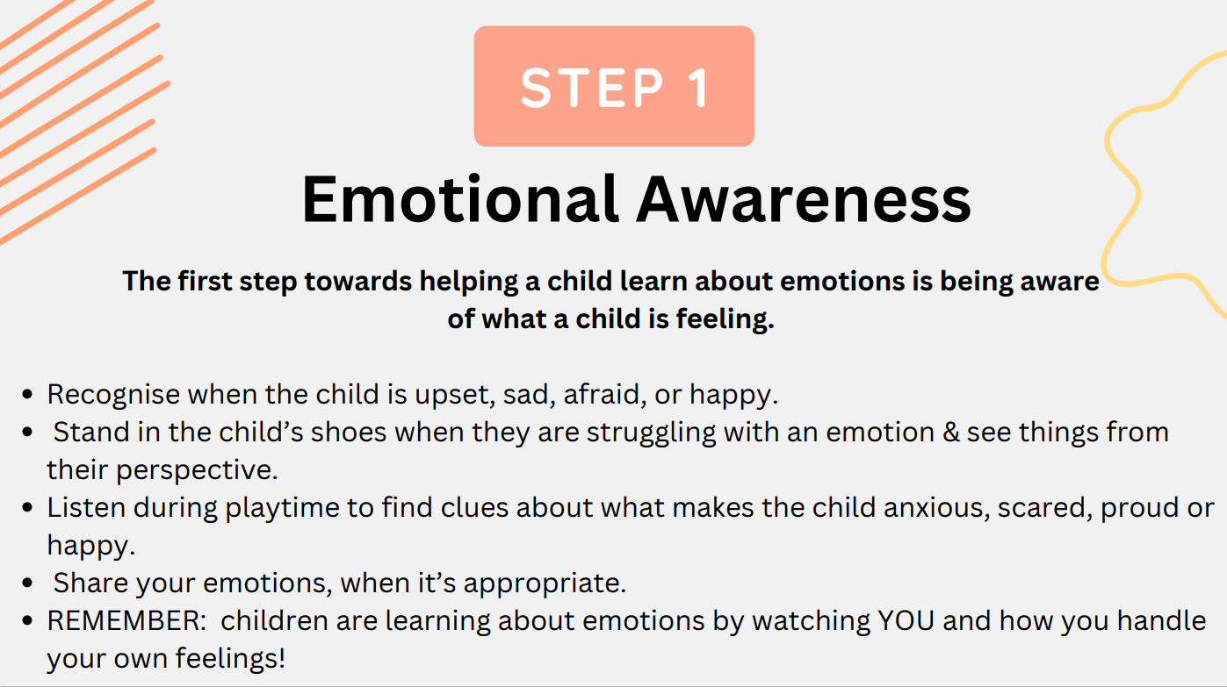

Slide 11


Slide 12


Slide 13
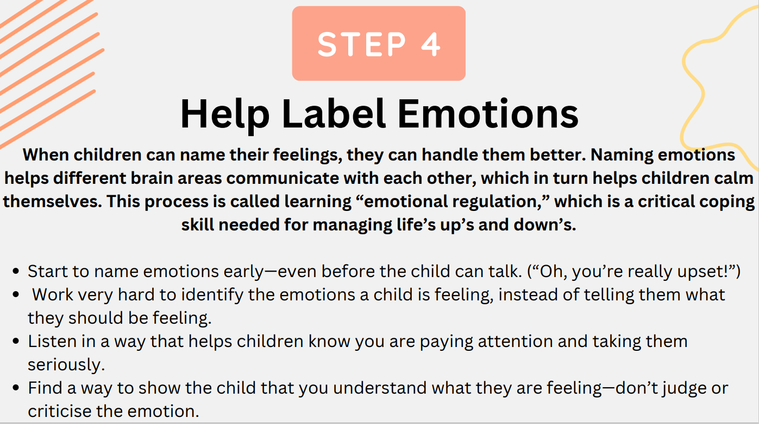

Slide 14
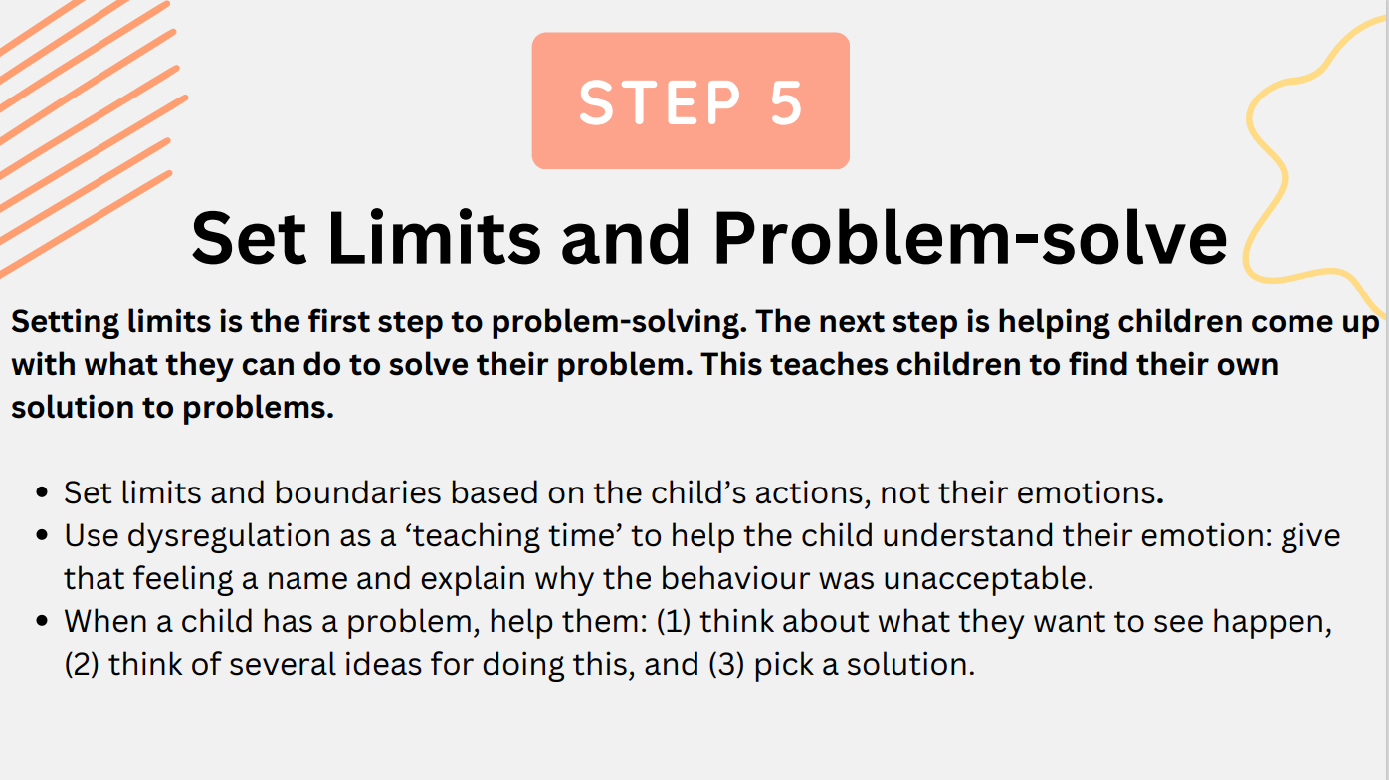

Slide 15


Slide 16
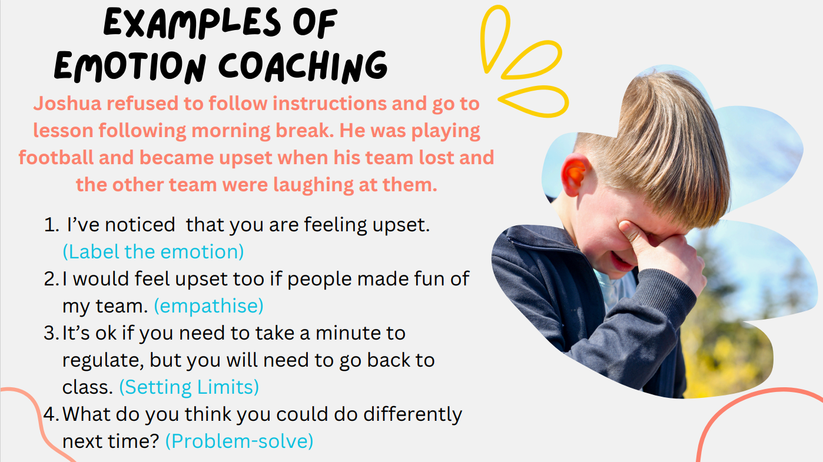

Slide 17
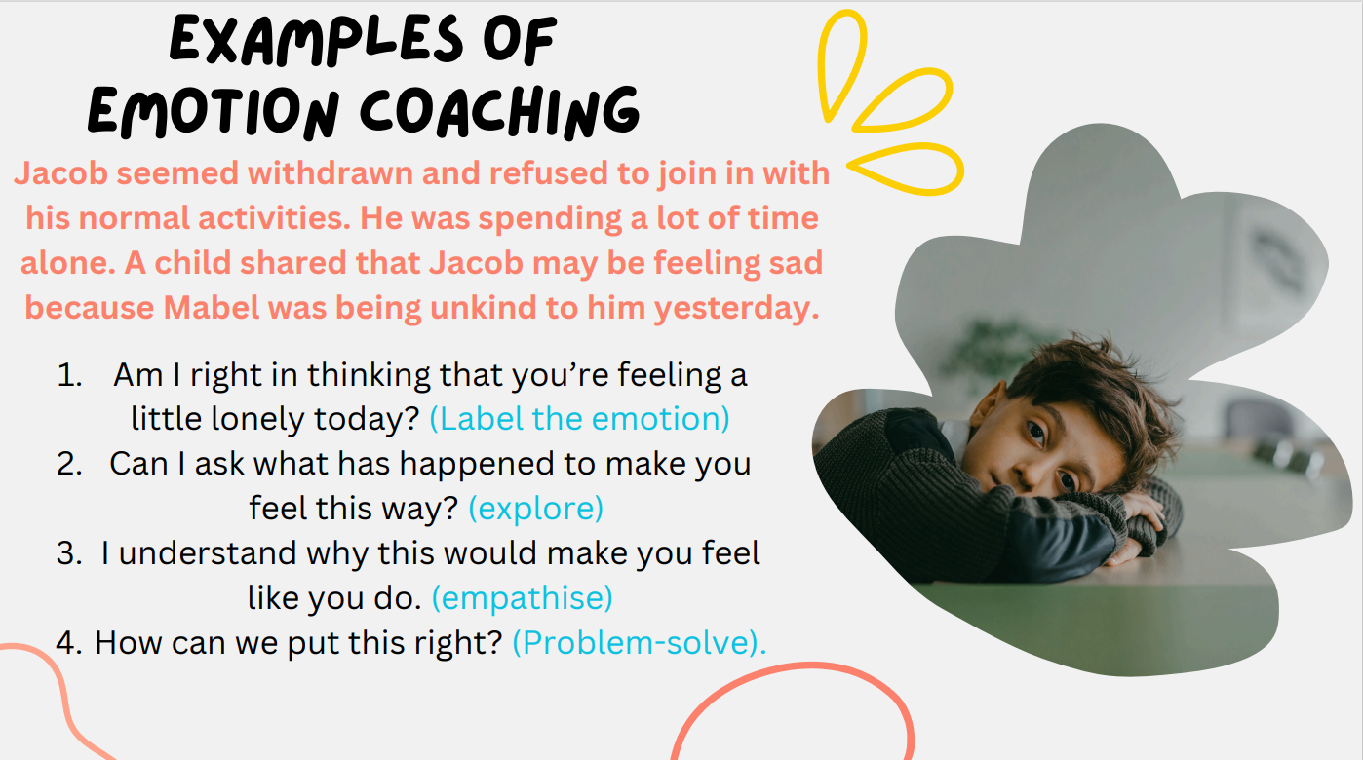

Slide 18


Slide 19


Slide 20


