Slide 1

St James CE Primary School
Year 5

Slide 2
Welcome to Year 5
Miss Newton
5N Teacher
Phase Leader
Miss Oddy
5N LSP
Mrs Thomas
5T Teacher
Mrs Lloyd
5T LSP
Mrs Hey
PPA Cover
Miss Dale
PPA Cover

Slide 3

Our School Vision and Values
Children are at the centre of everything that we do. This is underpinned by our vision of
'Let us love...Let us thrive'
and core values of love, friendship, respect, endurance, honesty, peace.

Slide 4


Slide 5
Lines of Communication
Class
Teacher
Phase Leader
Deputy Head
Head Teacher
You can leave messages for your child’s class teacher by calling the office on 0121 552 5491 or
emailing contact.us@stjamespri.uk.
Please save contact.us@stjamespri.uk as a safe sender and check junk mail as this is where ARBOR
emails are being sent to.
Medical – resent out today – please complete forms and send in your child’s
medication ASAP.

Slide 6
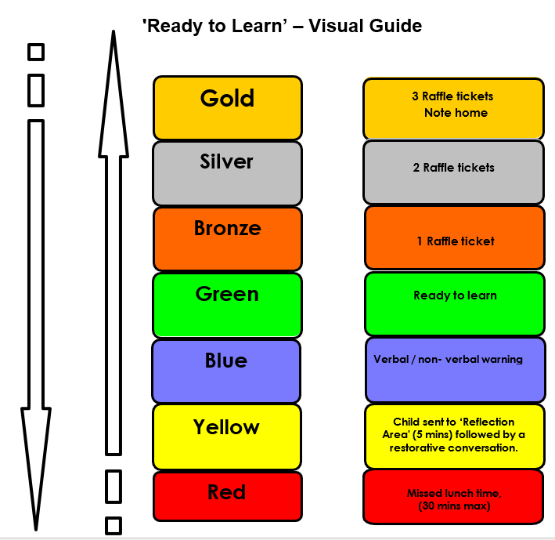
Ready to Learn Behaviour System
Between each stage, children are given opportunities to change their behaviour. A range of positive behaviour management strategies, including warnings or reminders will be given before a consequence.
Children will be given the opportunity to move from the negative consequence stage back to the positive – back to green and above.

Slide 7
Uniform
The St James school uniform consists of:
All children (Nursery – Year 6) need:
burgundy St James crew neck sweat shirt/sweatshirt cardigan
white polo t-shirt or shirt
grey or black school trousers/skirt/pinafore dress
black flat sensible school shoes (shoes are to be plain with no coloured logos)
St James book bag
In warm weather girls may wear a red gingham dress and boys grey/black shorts
Optional burgundy St James zip fleece
In warm weather caps and sunglasses are encouraged
PE Uniform – White top and black short/jogging bottoms

Slide 8
Homework – Upper KS2
Reading daily (at least 3 times).
A spelling list will be provided each week on a specific day and tested the following week..
TTRockstars 3 times a week
Children may be given a specific activity linked to an area of the curriculum.
British Values creative project

Slide 9
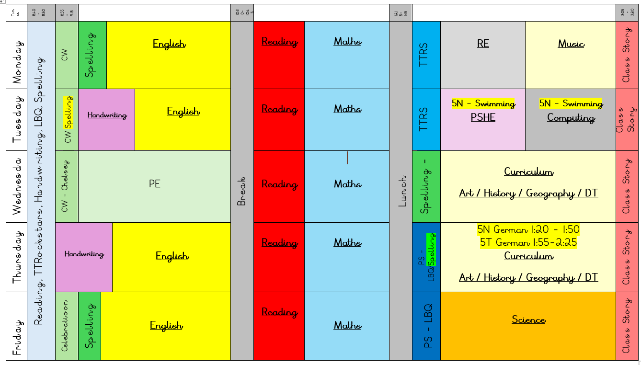
Our Daily Routine

Slide 10
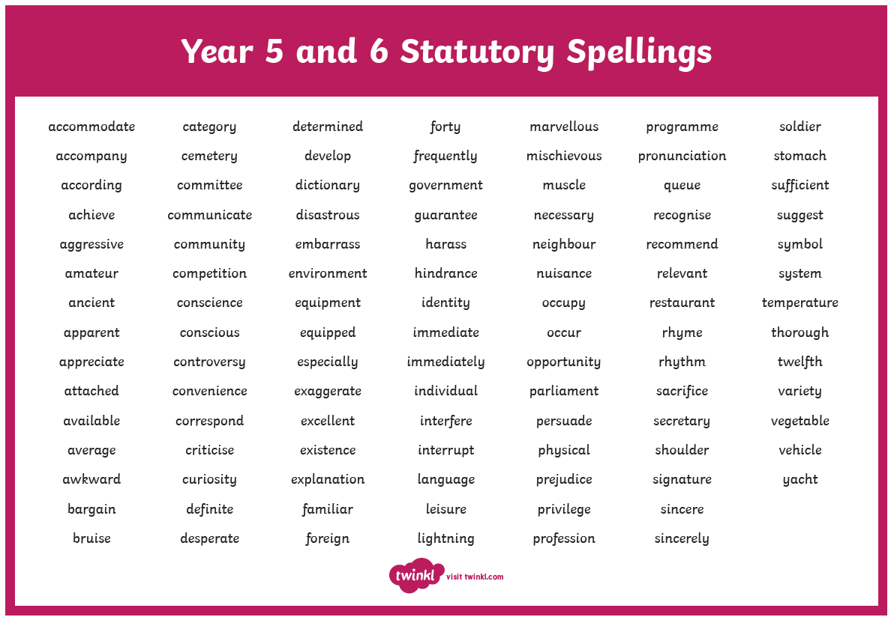
Spellings
Year 5/6 Statutory Spellings
Ed Shed – Spelling Shed

Slide 11

TTRockstars
TTRockstars sessions in school and at home
Improved knowledge of times tables, helps with every day mathematics lessons.

Slide 12







Reading

Slide 13
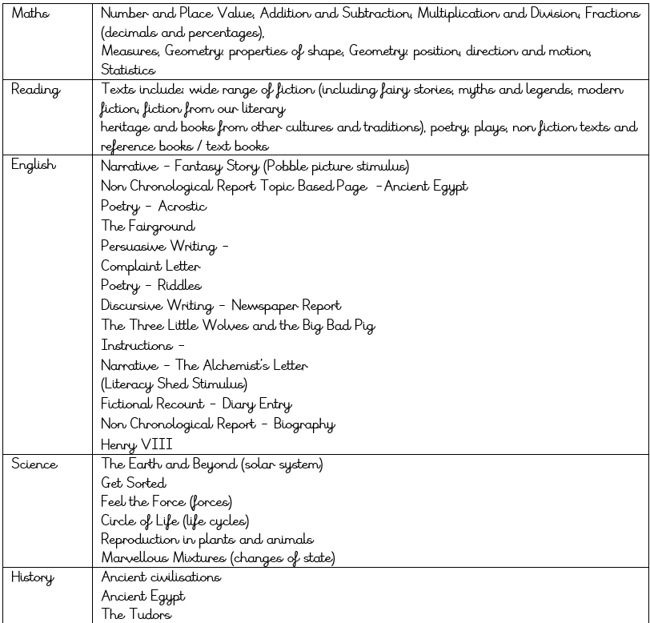
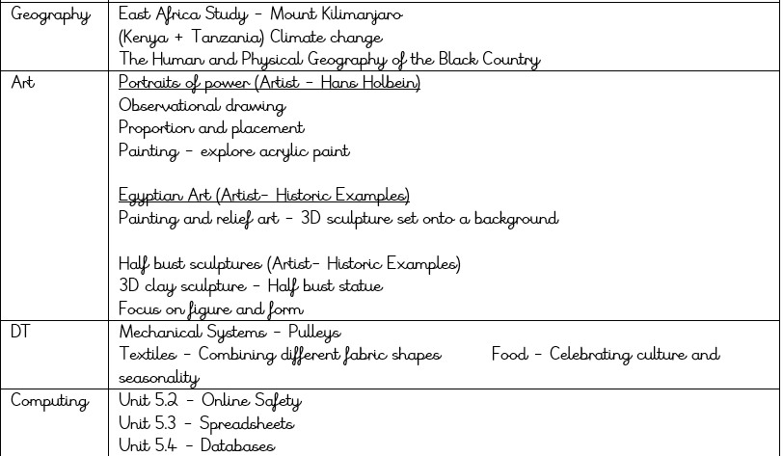
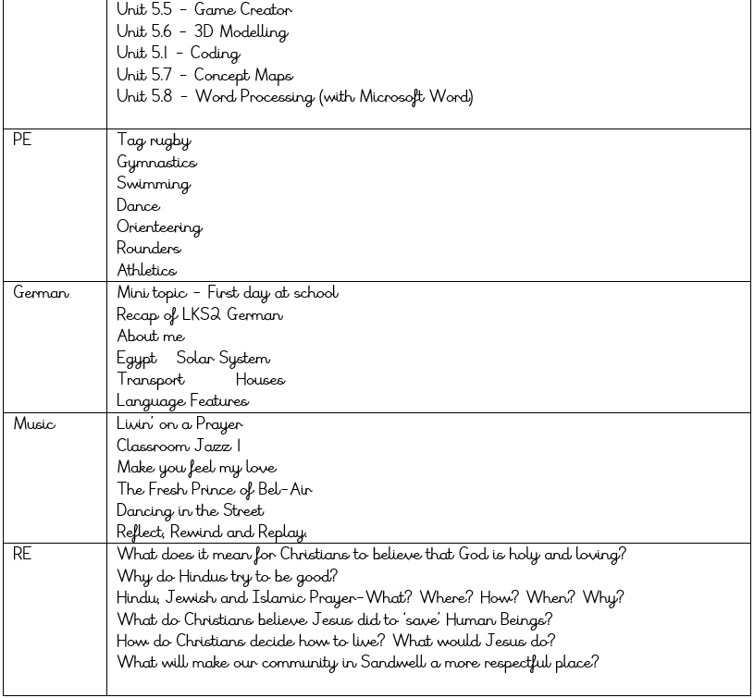

Slide 14
Thank you for attending today!

