Slide 1

St James CE Primary School
Year 5

Slide 2
Welcome to Year 5
Mrs Thomas
Mrs Sanghera
Mrs Hey
HLTA
Mr Dawson
Mrs Melvin
Mr Stokes
Sports Coach/HLTA
Phase leader: Mrs Thomas
Assistant Headteacher: Mrs Zmitrowicz and Miss Manning
Deputy Headteacher: Mrs Dearn
Headteacher: Mr Heather

Slide 3

Our School Vision and Values
Children are at the centre of everything that we do.
This is underpinned by our vision of
'Let us love...Let us thrive’
and core values of love, friendship, respect, endurance, honesty, peace.

Slide 4


Slide 5
Lines of Communication
Class
Teacher
Phase Leader
Deputy Head
Head Teacher
You can leave messages for your child’s class teacher by calling the office on 0121 552 5491,
emailing contact.us@stjamespri.uk or messaging on the Arbor App. We aim to respond to communications within 5 working days.

Slide 6
School Website
The school website is up-to-date with all of the information that you need:
School diary (found on the school’s home page or under the parent information tab)
Year group information (found under the year groups tab)
Uniform expectations
School policies
Curriculum information
Our Christian vision and values
SEND information

Slide 7
School Website
An email will be sent regarding important information linked to your child and then this information will be shared on our school website.
It is imperative that you keep up to date with the school website and continue to check your emails (including your junk and spam folders).
Note: you will not receive multiple emails reminding you of upcoming events or deadlines.

Slide 8
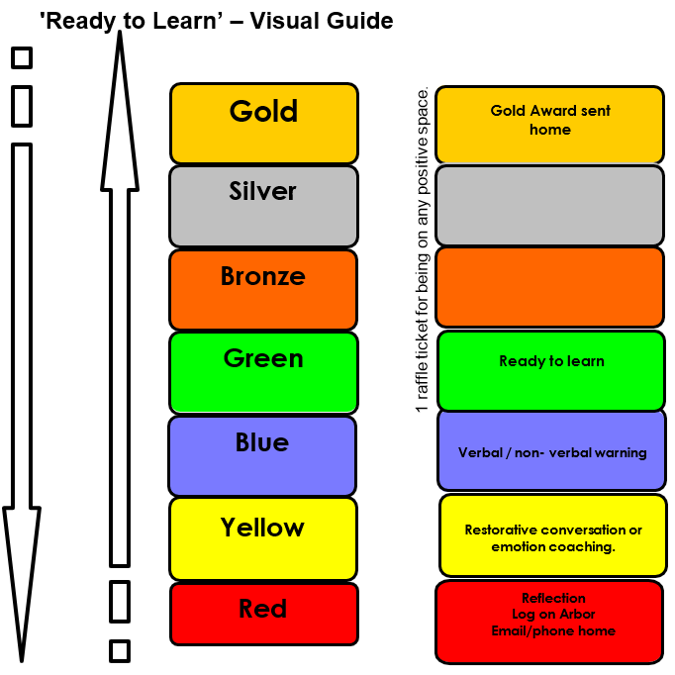
Ready to Learn Behaviour System
Between each stage, children are given opportunities to change their behaviour. A range of positive behaviour management strategies, including warnings or reminders will be given before a consequence.
Children will be given the opportunity to move from the negative consequence stage back to the positive – back to green and above.
If your child receives reflection time, you will be notified via email and can speak to staff at the end of the school day.

Slide 9
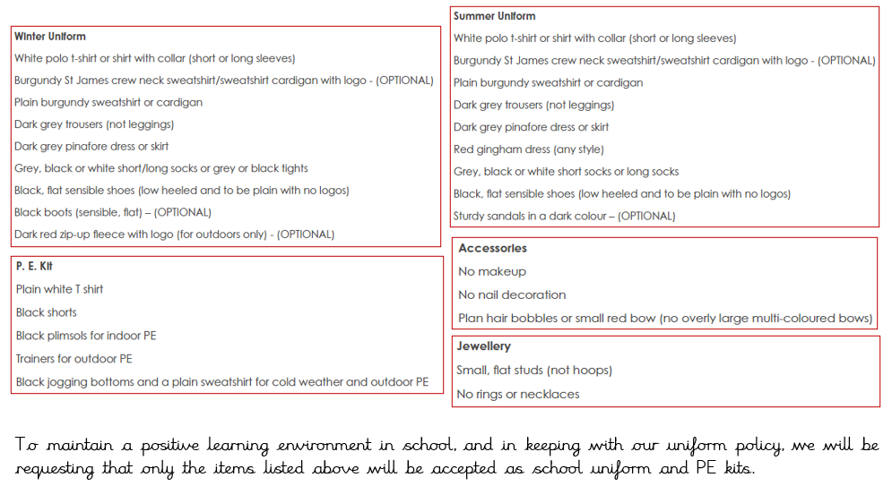
Uniform

Slide 10
Homework – Phase 5/6
Reading daily.
TTRockstars 3 times a week
Spellings daily / Phase 5/6 statutory spellings
Children may be given a specific activity linked to an area of the curriculum.
School value creative project - FRIENDSHIP
LBQ homework set weekly
5T LBQ code: z8 37 fe 6n. 5S LBQ code: 5z 52 ju gz

Slide 11
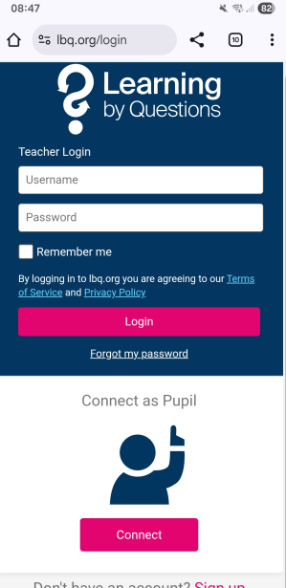
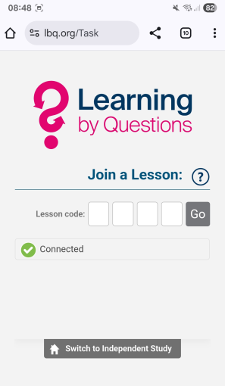
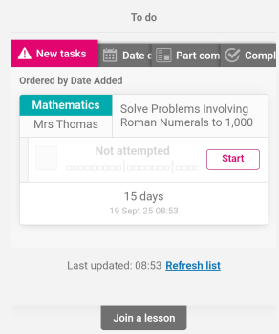
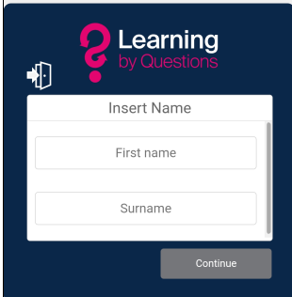



Name and password (number, colour, object)

Slide 12
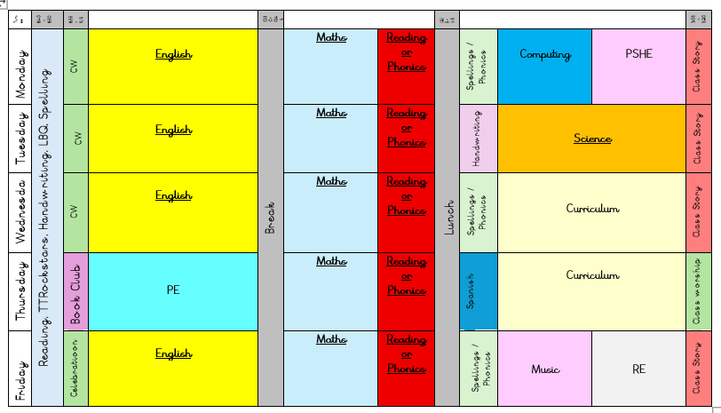
Our Daily Routine

Slide 13

TTRockstars
TTRockstars sessions in school and at home
Improved knowledge of times tables, helps with every day mathematics lessons.
Notes:
Delete if in Nursery, Reception and Y1.

Slide 14
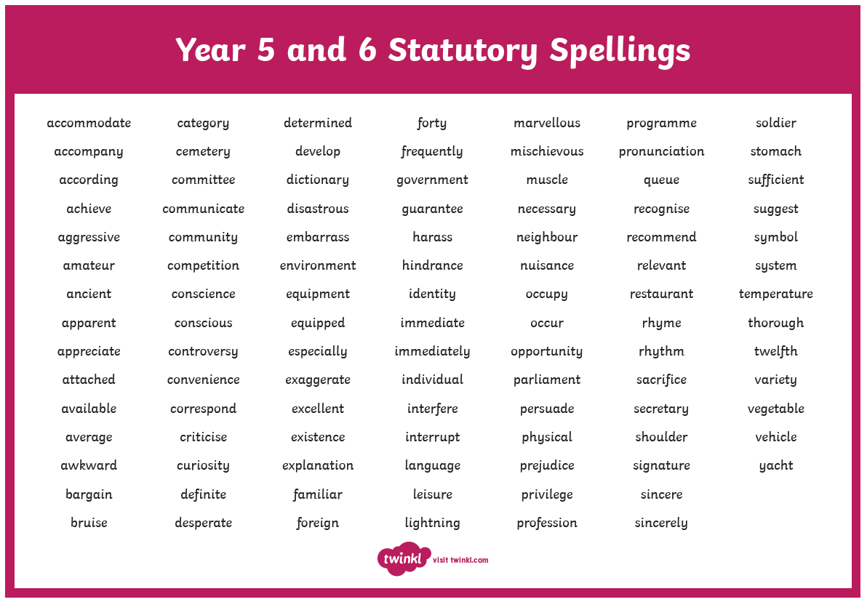
Spellings
Year 5/6 Statutory Spellings
Ed Shed – Spelling Shed

Slide 15







Reading

Slide 16
Writing
Use verb tenses consistently and correctly throughout most of their writing.
Full stops and capital letters Question marks and exclamation marks Commas in a list Commas for clauses (e.g. My favourite flavour of ice cream is vanilla, but my brother prefers chocolate). Commas after fronted adverbials (e.g. Deep in the heart of the forest, there was an abandoned cottage). Commas for clarity (e.g. He sprang to his feet quickly, realising someone was at the door / He sprang to his feet, quickly realising someone was at the door). Apostrophes for possession Apostrophes for contraction Inverted commas Parenthesis (brackets, dashes, commas)
Spell words correctly from the Year 3/4 spelling list and some words from the Year 5/6 spelling list using known spelling strategies and dictionaries to check the spelling of uncommon or more ambitious vocabulary. (see supporting word list)
Write legibly, fluently and with increasing speed.
Write effectively for a range of purposes and audiences,
In narratives, describe settings, characters and atmosphere. (child may use a range of descriptive techniques e.g., expanded noun phrases, similes/metaphors, personification etc.)
Begin to convey character and advance the action through dialogue, maintaining a balance of speech and description. (e.g. include emotions, actions and characters’ thoughts in your dialogue - With a psychotic smirk, the witch whispered: “I have a gift for her, too.” She edged towards the crib. The crowd gasped in fear).
Modal verbs Sentence types Coordinating conjunctions (and but so) Subordinating conjunction (although, after, as, when, if, that, even though, because) Adverbials Synonyms to avoid repetition Expanded noun phrases | Modal verbs to indicate possibility (e.g. might, should, will, must, could, would etc.)
 | Range of sentence types (e.g. simple, compound, complex).

Slide 17
Maths
4. Fractions, Decimals and Percentages
Compare and order fractions.
Convert between improper fractions and mixed numbers.
Add and subtract fractions with the same denominator and related denominators.
Multiply fractions by whole numbers.
Understand decimals up to 3 decimal places.
Convert between fractions, decimals and percentages.
5. Measurement
Convert between different units of metric measure (e.g. km to m, g to kg).
Understand and calculate perimeter and area.
Use timetables and calculate time intervals.
6. Geometry
Identify 3D shapes and their properties.
Understand angles: measure, draw and calculate angles in shapes.
Use coordinates and describe translations.
7. Statistics
Interpret and draw line graphs and tables.
Solve problems using information presented in graphs.
1. Number and Place Value
Read, write, order and compare numbers up to 1,000,000.
Understand the value of each digit in large numbers.
Count forwards and backwards in powers of 10.
Interpret negative numbers in context.
2. Addition and Subtraction
Add and subtract numbers mentally and using formal written methods.
Solve multi-step problems using addition and subtraction.
Use rounding to estimate answers.
3. Multiplication and Division
Multiply and divide numbers up to 4 digits by 1- and 2-digit numbers.
Understand factors, multiples, prime numbers, square and cube numbers.
Solve problems involving multiplication and division, including scaling and simple fractions.

Slide 18
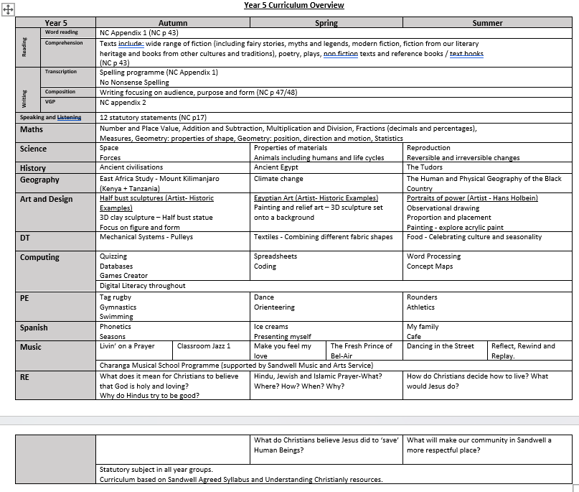
Year overview

Slide 19
PSHE
Autumn – Relationships and Friendships
Healthy friendships, peer pressure, conflict resolution, acceptable and unacceptable touch, discrimination, bullying
Spring – Living in the wider world
Environmental issues, purpose and uses of media including fake news, stereotypes, staying safe online, careers and jobs
Summer – Physical health and mental well-being
Importance of sleep, sun protection, medicines, allergies, vaccinations, puberty, physical and mental changes
(including accurate names of internal and external genitalia) keeping safe, risk taking, first aid, FGM

Slide 20
Additional Information
PE day – Thursday
Mrs Thomas – Management time – Monday PM until February half term then Monday AM
Friday – 5T taught by Mr Sanga
Forest school – added to the school diary/website when dates are booked
Celebration Assembly will be on a Friday morning at 9am (invited in by email).
Easter Service
Mobile phones – school and safety
Walk to school

Slide 21
Thank you for attending today!
Questions?

