Slide 1

St James CE Primary School
Year 6

Slide 2
Welcome to Year 6
Mrs Hey
PPA Cover
Miss Hill
6H Teacher
Miss Manning
6M Teacher
Assistant Head
Miss Dale
PE Teacher
Ms Lindsay
Mr Khan
6H TAs
Mrs Ball
Mr Stokes
6M TAs
Ms Hipkiss
Cover Teacher

Slide 3

Our School Vision and Values
Children are at the centre of everything that we do. This is underpinned by our vision of
'Let us love...Let us thrive'
and core values of love, friendship, respect, endurance, honesty, peace.

Slide 4


Slide 5
Lines of Communication
Class
Teacher
Phase Leader
Deputy Head
Head Teacher
You can leave messages for your child’s class teacher by calling the office on 0121 552 5491 or
emailing contact.us@stjamespri.uk

Slide 6
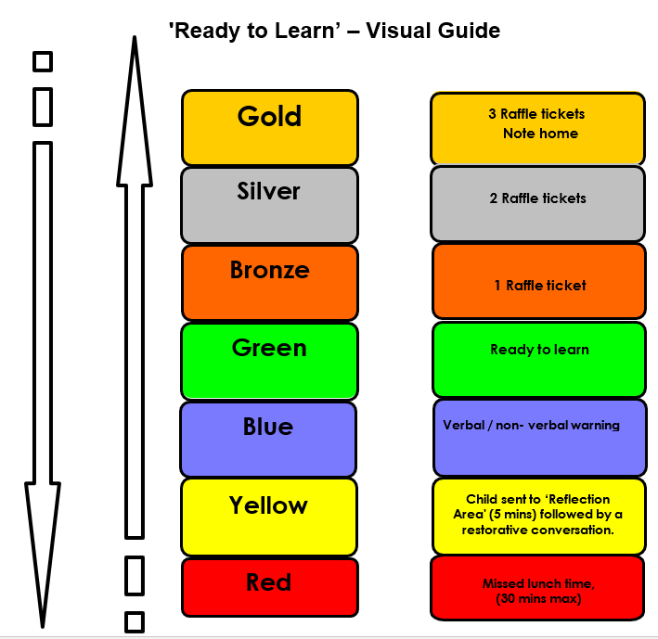
Ready to Learn Behaviour System
Between each stage, children are given opportunities to change their behaviour. A range of positive behaviour management strategies, including warnings or reminders will be given before a consequence.
Children will be given the opportunity to move from the negative consequence stage back to the positive – back to green and above.

Slide 7
Uniform
The St James school uniform consists of:
All children (Nursery – Year 6) need:
burgundy St James crew neck sweat shirt/sweatshirt cardigan
white polo t-shirt or shirt
grey or black school trousers/skirt/pinafore dress
black flat sensible school shoes (shoes are to be plain with no coloured logos)
St James book bag
In warm weather girls may wear a red gingham dress and boys grey/black shorts
Optional burgundy St James zip fleece
In warm weather caps and sunglasses are encouraged
PE Uniform – Plain top (no logos or designs) and black shorts/jogging bottoms

Slide 8
Homework – Upper KS2
Reading daily.
TTRockstars 3 times a week
Children may be given a specific activity linked to an area of the curriculum.
British Values creative project
Towards the start of SATs, children will be set LBQ (online) homework to complete.

Slide 9
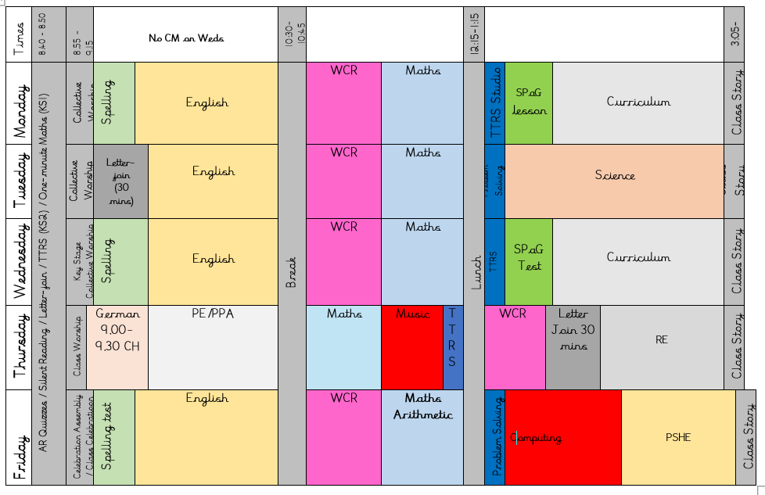
Our Daily Routine

Slide 10
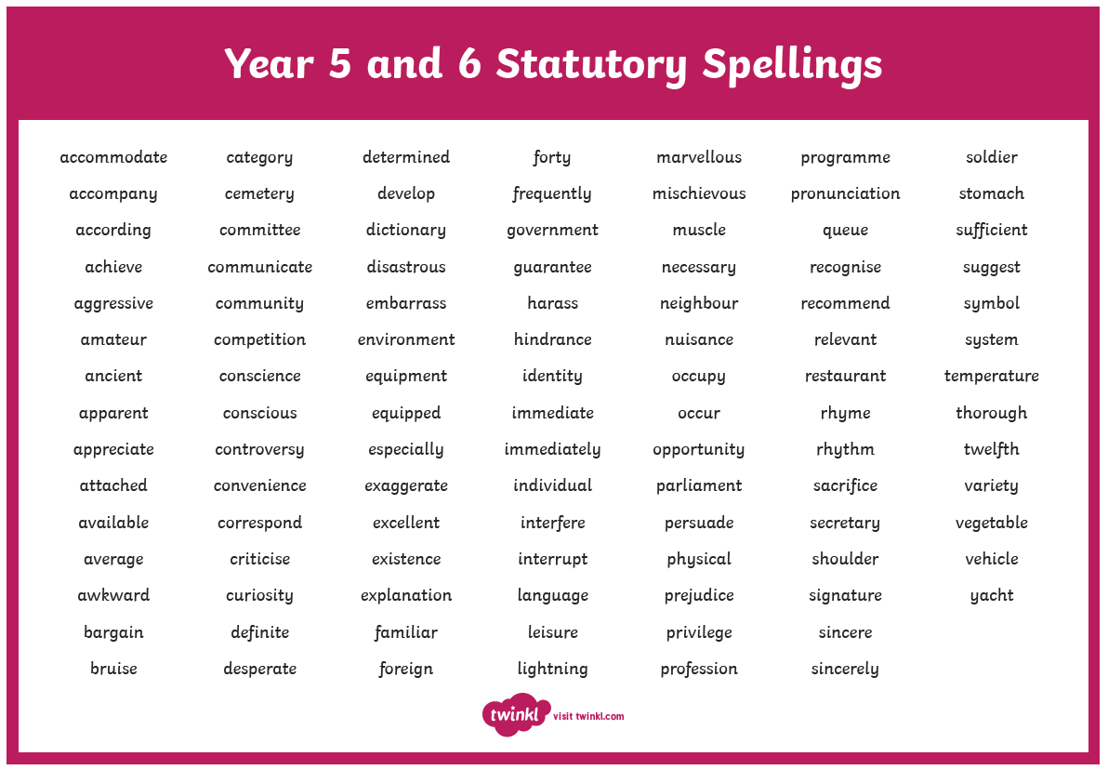
Spellings
Year 5/6 Statutory Spellings
Ed Shed – Spelling Shed

Slide 11

TTRockstars
TTRockstars sessions in school and at home
Improved knowledge of times tables, helps with every day mathematics lessons.

Slide 12






Reading

Slide 13
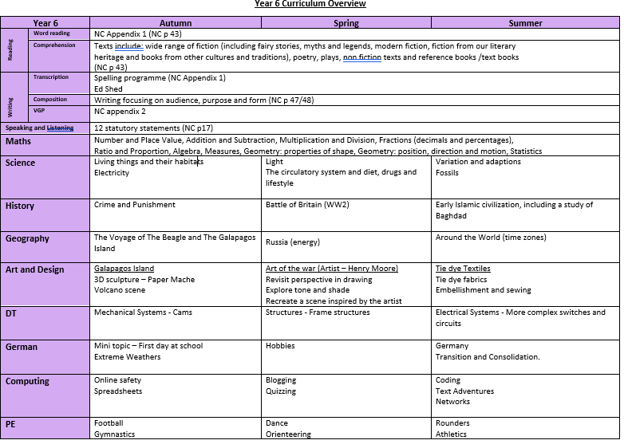
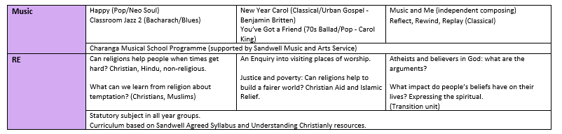

Slide 14
SATs
SATs are the standardised assessment tests administered by primary schools in England to children in Year 2 and Year 6 to check their educational progress.​
Children will sit papers in:​
Reading​
SPaG (Spelling, Punctuation and Grammar)​
Maths (arithmetic paper and two reasoning papers)​
​
The SATS will take place from Monday 12th May 2025 – Thursday 15th May 2025.​
​
Additional information regarding the tests will be shared in more detail in the spring term. ​

Slide 15
Thank you for attending today!

