Slide 1

Parent’s Evening Any questions, please speak to Mr Heather, Mrs Dearn or a Governor.

Slide 2

Safeguarding Team

Slide 3



YOU don’t need to be an EXPERT … be a PARENT
It’s your choice - Don’t let others dictate when the right time is to use tech.
Stay involved – make time to communicate, talk about what they are doing. What do they enjoy? What makes them laugh?
Don’t quiz them – have regular conversations. What's their favourite app? What is the best site to learn new things from?
Join in - watch them play a game and join in. Who are they playing with? Do they know the other players?
‘Show me how…’ – ask their advice to help you with your privacy settings, who you should add as a friend, are there any risks?
Lead by example - children learn as much from watching as they do from being told not to do something, so model good behaviour
Reassure them - tell them that they won't get in trouble and that you are always there to help.
Notes:
ASK – What do you do that works well? Share good practice
REMIND - You do not need to be a tech expert to help your child with staying safe online. It’s ultimately about communication and being proactive.

Slide 4
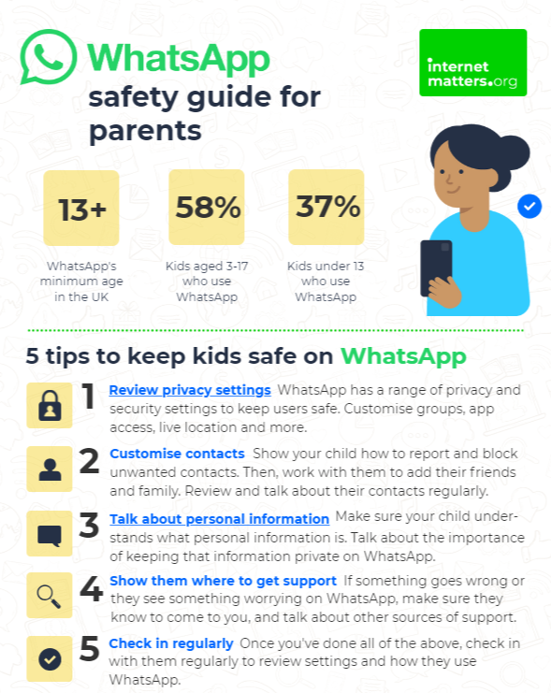
Visit https://www.internetmatters.org/resources/whatsapp-safety-a-how-to-guide-for-parents/#whatsapp-safety-tips for advice for parents
Notes:
SHARE – 5 top tips from the parent safety guide at https://www.internetmatters.org/resources/whatsapp-safety-a-how-to-guide-for-parents/#whatsapp-safety-tips
EXPLAIN – it’s useful to talk with children about etiquette when using group chats e.g.
how to communicate
what language to use/not use
recognition that others may see your messages if copied and shared
what to do if someone is unkind to them or others etc.

Slide 5
How can YOU GET INVOLVED?
ASK what type of games your child enjoys – are they age-appropriate?
PLAY games together - keep the tech in shared spaces rather than bedrooms
TALK about who they are playing with - what information are they sharing?
EXPLAIN what is/isn’t appropriate to share, e.g. personal details to identify them/location
AGREE how they will spend their money online
DISCUSS what they would do if they were bullied online, and what steps to take
DECIDE how long is appropriate to play in one session - how many sessions a day
SETUP these restrictions in parental settings with your child
Visit gaming.lgfl.net for advice and activities to keep them safe
Source: Children and parents: media use and attitudes report 2024

Slide 6


PEGI helps parents to make informed decisions when buying video games:
The age rating confirms that the game content is appropriate for players of certain age
It considers the age suitability of a game, not the level of difficulty
pegi.info
Notes:
UK uses the PEGI (Pan European Game Information) system to give games their age ratings to help people make informed decisions when buying video games or apps through the use of age recommendations and content descriptors. .You can find out more here: https://parentzone.org.uk/article/pegi-games-ratings#:~:text=The%20UK%20uses%20the%20PEGI,about%20how%20PEGI%20classifies%20games.

Slide 7

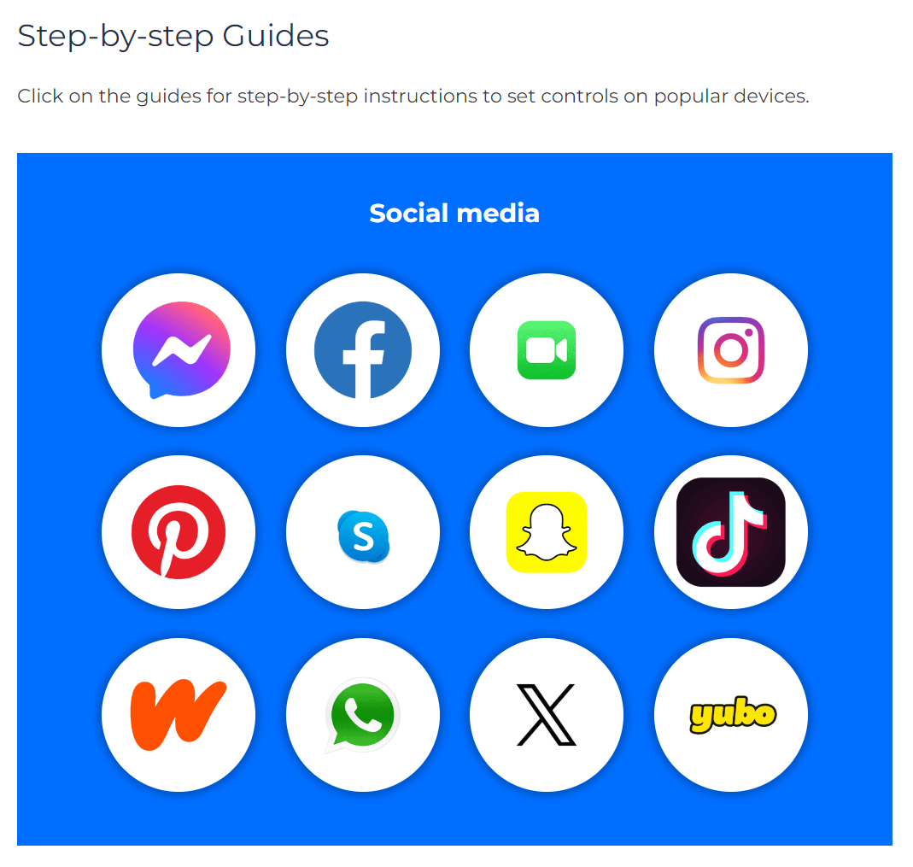
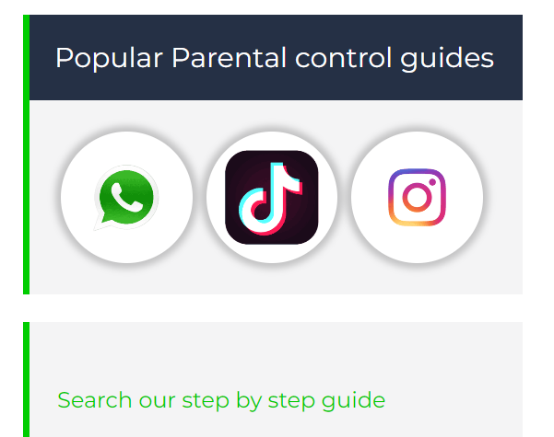
Do YOU know HOW TO REPORT to apps / sites?
Internet Matters has helpful guides for social media apps and sites at internetmatters.org/parental-controls/social-media
Notes:
Each social media site has it’s own processes for reporting inappropriate/harmful content.

Slide 8
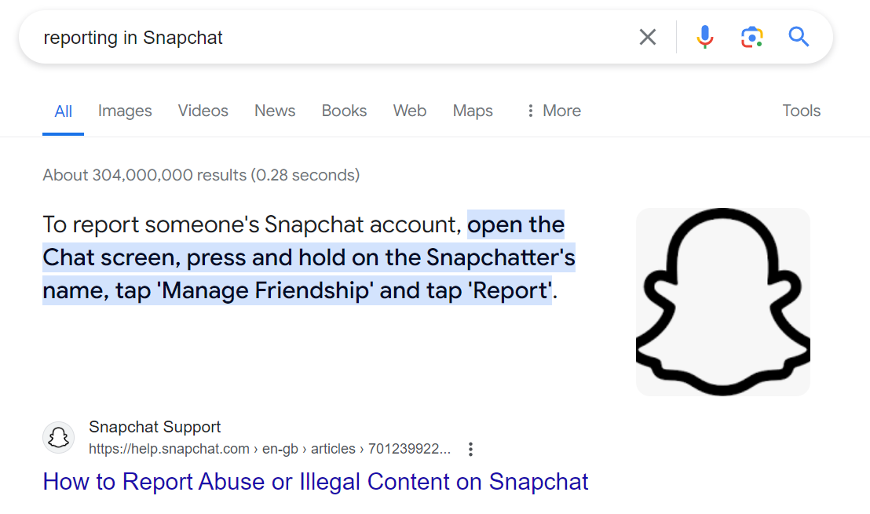
A simple Google search with the site name, e.g. ‘reporting in Snapchat’ will bring up the steps to take and signpost to the reporting page
Notes:
TELL – you can also do a Google search by typing ‘reporting in______________________________ (name of platform)’

Slide 9




UK Reporting Helplines and Services for Children and Young People
NCA
Young people can report concerns about child sexual abuse and exploitation to NCA
Report Remove
A free tool that allows children to report nude or sexual images and videos of themselves that they think might have been shared online
ChildLine
A free, private and confidential service where CYP can talk about anything to a trained counsellor, online or on the phone
Call 101 or 999 if there is an immediate risk of harm to your child
Go to reporting.lgfl.net to find out more
Notes:
TELL – Talk to your children about these free reporting helplines to support them if they are worried.
For older children, The Mix provides help for young people aged 11-25

Slide 10
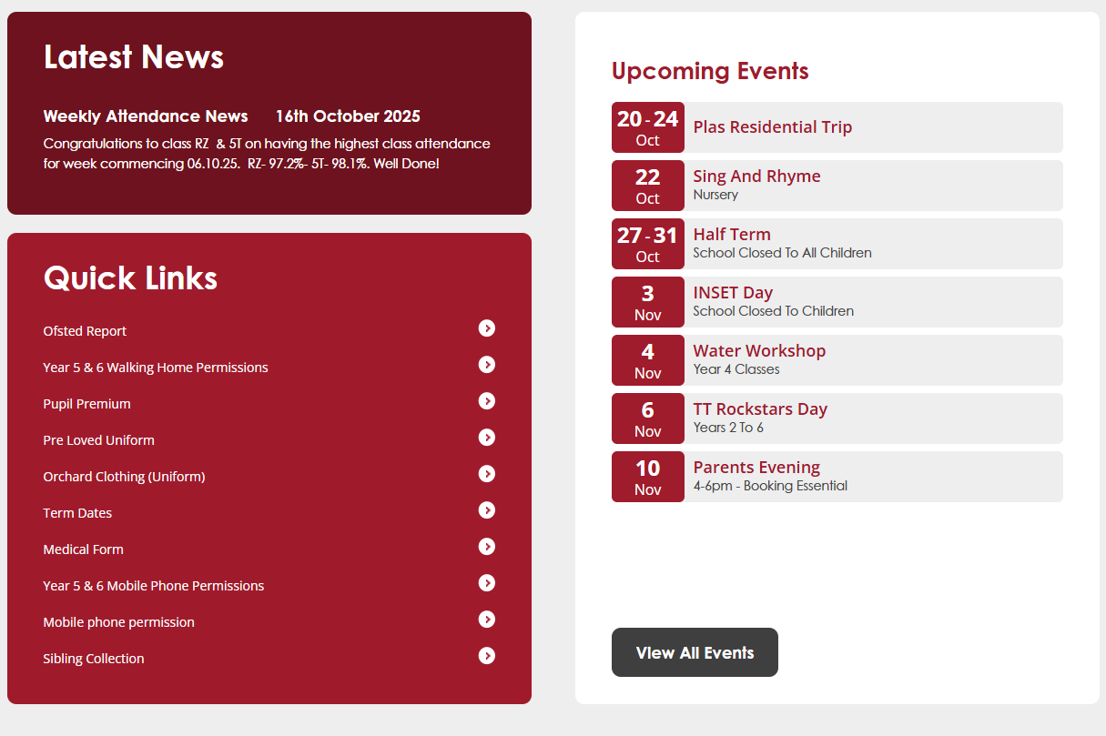
School Website
Calendar is up to date with upcoming events
Quick links for important documents

Slide 11


Year Groups
Select your child’s year group for important information relating to them.
This will include dates for PE or Forest School.
Click here

Slide 12
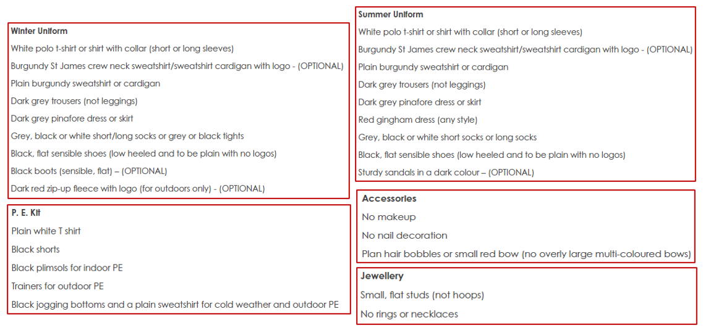
Uniform expectations

Slide 13
Thank you for your support in:
- ensuring your child(ren) attend school regularly and on time.
- providing your child(ren) with the correct uniform.
- communicating well with school to resolve concerns.
- showing our school values.
- completing homework (phonics/reading, spellings, maths).

Slide 14
Let us love… Let us thrive…

Slide 15

Please take a moment to scan the QR code and complete the survey.
Thank you

