Slide 1

Parents’ Evening Internet Safety
Information for Parents

Slide 2



YOU don’t need to be an EXPERT … be a PARENT
It’s your choice - Don’t let others dictate when the right time is to use tech.
Stay involved – make time to communicate, talk about what they are doing. What do they enjoy? What makes them laugh?
Don’t quiz them – have regular conversations. What's their favourite app? What is the best site to learn new things from?
Join in - watch them play a game and join in. Who are they playing with? Do they know the other players?
‘Show me how…’ – ask their advice to help you with your privacy settings, who you should add as a friend, are there any risks?
Lead by example - children learn as much from watching as they do from being told not to do something, so model good behaviour
Reassure them - tell them that they won't get in trouble and that you are always there to help.
Notes:
ASK – What do you do that works well? Share good practice
REMIND - You do not need to be a tech expert to help your child with staying safe online. It’s ultimately about communication and being proactive.

Slide 3


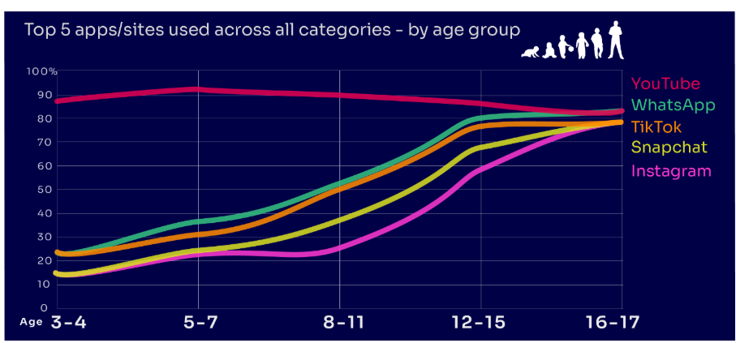
Are you FAMILIAR WITH THE APPS and GAMES your child is on?
YouTube is the most popular, but the appeal of many social media platforms varies by age
under two in ten of all 3-4-year-olds use Instagram and/or Snapchat
this rises to eight in ten among 16-17s
under a quarter of all 3-4-year-olds use WhatsApp
this rises to over eight in ten of all 16-17-year-olds
Go to apps.lgfl.net for guidance on apps and social media sites
Source: Children and parents: media use and attitudes report 2024
Notes:
YouTube is the most-used app or site among the children in our study, with more than eight in ten 3- 17-year-olds using it. However, while YouTube is a popular app across all age bands, some sites or apps grow in popularity with age. For example, just under two in ten of all 3-4-year-olds use Instagram and/or Snapchat (17% in each case) but this rises to eight in ten among 16-17s (for both apps). Similarly, just under a quarter (23%) of all 3-4-year-olds use WhatsApp, and this rises to over eight in ten (83%) of all 16-17-year-olds. This underlines the more interconnected and social nature of older children’s online behaviours; indeed, half (49%) of all 16-17-year-olds use all five of the top apps/sites (YouTube, WhatsApp, TikTok, Snapchat and Instagram).
REMIND – your children need to be 13+ to use these platforms (See slide 39)

Slide 4

What might they NOT BE TELLING YOU?
Nearly six in ten (58%) 8-17s use multiple profiles on at least one social media platform:
(23%) said it was because one account was just for parents/family to see
13% said one account was for the ‘real me’ and another contained edited/filtered posts or photos
Source: Children and parents: media use and attitudes report 2024
Notes:
TELL - This demonstrates that at least some children feel the need to present distinct aspects of themselves on social media, depending on the audience.

Slide 5


What about WHATSAPP?
Do you know the minimum age to use this?
What are the risks?
Unwanted contact | to contact somebody on WhatsApp, all you need is their phone number, which could expose you to unwanted messages or calls
Inappropriate content | messages are end-to-end encrypted which means that the content cannot be monitored. This means that your child could see or hear harmful or upsetting content e.g. pornography or violence.
Location sharing | live location feature means that your child could reveal their current location to others
Cyberbullying | children could be bullied, feel left out or deliberately excluded or removed from groups
Oversharing | privacy features, such as disappearing and ‘view once’ messages, might mean that your child feels safe to reveal private or risky information or images. However, there is always a risk that this could be copied and shared
Notes:
TELL - WhatsApp let users send messages and content to contacts added to their account. To use the service in the UK, users must be 13-years-old or older (as of April 2024. The minimum age for WhatsApp used to be 16)

Slide 6
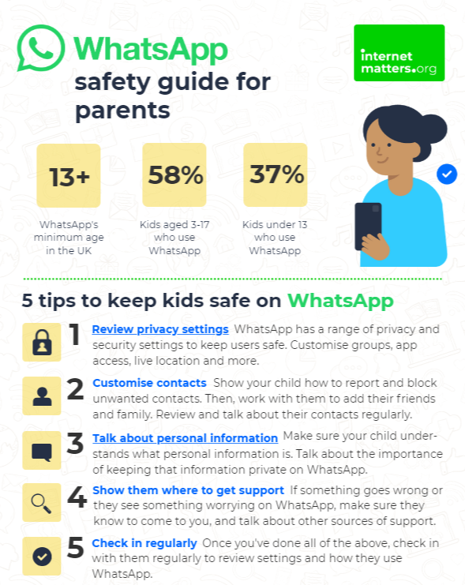
Visit https://www.internetmatters.org/resources/whatsapp-safety-a-how-to-guide-for-parents/#whatsapp-safety-tips for advice for parents
Notes:
SHARE – 5 top tips from the parent safety guide at https://www.internetmatters.org/resources/whatsapp-safety-a-how-to-guide-for-parents/#whatsapp-safety-tips
EXPLAIN – it’s useful to talk with children about etiquette when using group chats e.g.
how to communicate
what language to use/not use
recognition that others may see your messages if copied and shared
what to do if someone is unkind to them or others etc.

Slide 7
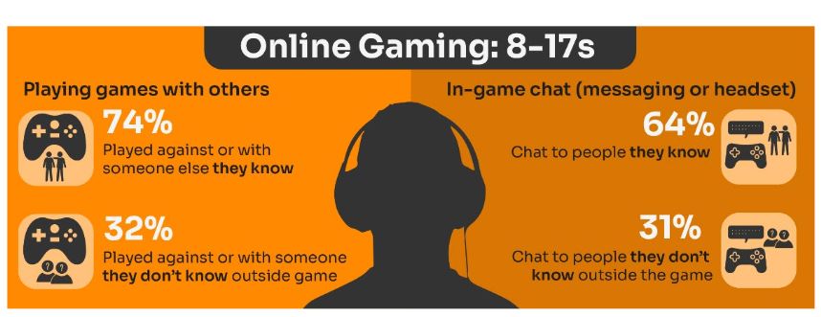
Do you know the DIFFERENCE between an ‘ONLINE’ FRIEND and a real one? How does this differ from your CHILD’S VIEW?
Are you familiar with who they are in contact with whilst playing games?
Have you asked about the chat facility?
Do you know the content and age restrictions for these games?
Visit gaming.lgfl.net for advice and activities
Source: Children and parents: media use and attitudes report 2024
Notes:
TELL:
Children often use online gaming as a tool to communicate with their peers, with 64% of 8-17s who game online chatting through the game with friends and/or people they know in real life.
However, 31% of children who game online, communicate with strangers as well.
A higher proportion of these children now play shooter games than last year (15% vs 10% in 2022). This may raise concerns about how age appropriate the games favoured by some younger children actually are.
Gaming is a central part of many children’s lives, and this year we have seen an increase in the already high proportion of children who game online, rising from 57% of all 3-17s in 2022 to 60% this year. This increase is driven by children at both ends of the age bands in Ofcom’s study: since 2022, we have seen increases in the proportion who play games online among 3-4s (23% vs 18%) and 5-7s (41% vs 34%) as well as among 16-17s (79% vs 72%). As in previous years, more boys aged 3-17 game online than girls of the same age (71% vs 58%).

Slide 8
How can YOU GET INVOLVED?
ASK what type of games your child enjoys – are they age-appropriate?
PLAY games together - keep the tech in shared spaces rather than bedrooms
TALK about who they are playing with - what information are they sharing?
EXPLAIN what is/isn’t appropriate to share, e.g. personal details to identify them/location
AGREE how they will spend their money online
DISCUSS what they would do if they were bullied online, and what steps to take
DECIDE how long is appropriate to play in one session - how many sessions a day
SETUP these restrictions in parental settings with your child
Visit gaming.lgfl.net for advice and activities to keep them safe
Source: Children and parents: media use and attitudes report 2024

Slide 9
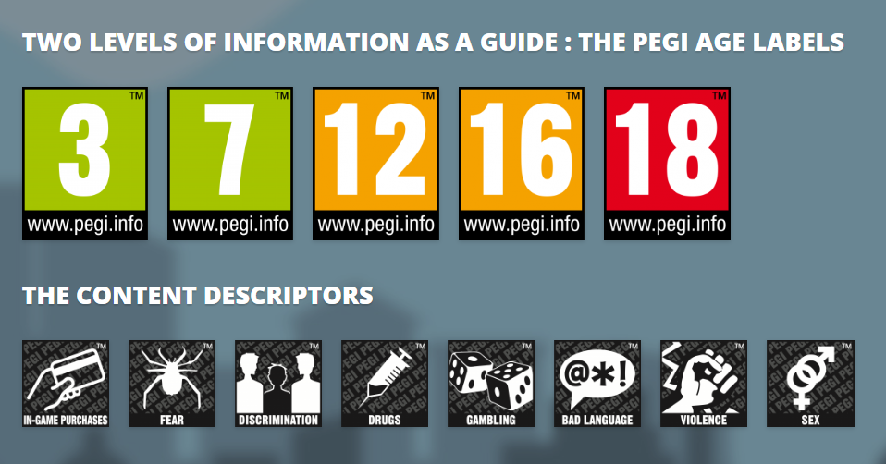
PEGI helps parents to make informed decisions when buying video games:
The age rating confirms that the game content is appropriate for players of certain age
It considers the age suitability of a game, not the level of difficulty
pegi.info
Notes:
UK uses the PEGI (Pan European Game Information) system to give games their age ratings to help people make informed decisions when buying video games or apps through the use of age recommendations and content descriptors. .You can find out more here: https://parentzone.org.uk/article/pegi-games-ratings#:~:text=The%20UK%20uses%20the%20PEGI,about%20how%20PEGI%20classifies%20games.

Slide 10
Are YOU aware of the MINIMUM AGE REQUIREMENT for social media?
More than a third (36%) say they would allow their child to have a profile on sites or apps before they had reached the minimum age.
84% of parents of 3-17s were aware of a minimum age requirement to have a profile on social media apps
BUT ONLY
32% of parents knew the
correct age requirement
(13 yrs)
Find ratings and reviews for parents on apps, games and social media at www.commonsensemedia.org
Source: Children and parents: media use and attitudes report 2024
Notes:
Only a third of parents know the correct minimum age requirement for most social media platforms. Although the majority of parents of all 3-17s (84%) are aware that there are minimum age requirements for using most social media apps or sites, only a third (32%) think, correctly, that the minimum age requirement for most social media sites and apps is 13. However, a further 31% put the minimum age at 14 or above. More than a third (36%) of parents of all 3-17s say they would allow their child to have a profile on sites or apps before they had reached the minimum age required. While this is unchanged at an overall level since 2022, there has been an increase in the proportion of parents of all 5-7s who say they would do this (30% vs 25% in 2022).

Slide 11

What about YOUNG PEOPLE?
Nearly eight in ten children are aware of minimum age requirements
Four in ten admit to giving a fake age online to access a new app/site
Up to a quarter had changed their date of birth on their profile since initially setting it up:
  Facebook (24%)
  TikTok (23%)
  Instagram and X/Twitter (both 19%)
Children’s Online User Ages 2023 Quantitative Research Study
Notes:
Up to a quarter of children aged 8-17 said they had changed their date of birth on their profile since initially setting it up.
• This was most likely to be cited for Facebook (24%) and TikTok (23%), followed by Instagram and X/Twitter (both 19%).
• Proportions doing this were higher among 8-12s for both TikTok and Instagram.
-

Slide 12
WHY DOES THIS MATTER?
Young people can get around age restrictions on apps and websites, increasing the risk of them coming to harm online
Many children have online profiles that make them appear older than they actually are – exposing them to content inappropriate for their age
Notes:
ASK – What kinds of risks do you think children could be exposed to? Can you give examples? (See slide 48 for a summary of related risks)

Slide 13

STAYING SAFE ONLINE AND REPORTING

Slide 14
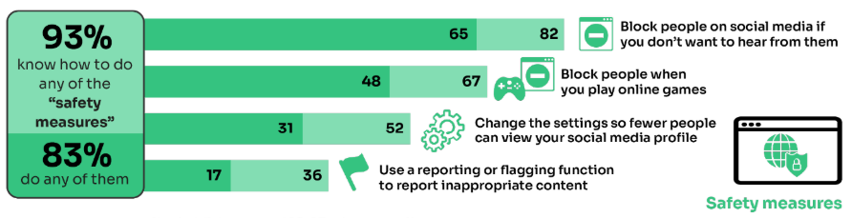
What do YOUNG PEOPLE do to STAY SAFE ONLINE?
Only 17% had used a reporting or flagging function
(36% were aware of these functions)
Go to reporting.lgfl.net to find out how to remove content from social media and where to report bullying, racial hatred, terrorism, sexual abuse and more
Source: Children and parents: media use and attitudes report 2024
Notes:
TELL - It is positive that children generally know about safety measures, but there seems to be a gap in their knowledge about reporting and putting the knowledge into practice.

Slide 15
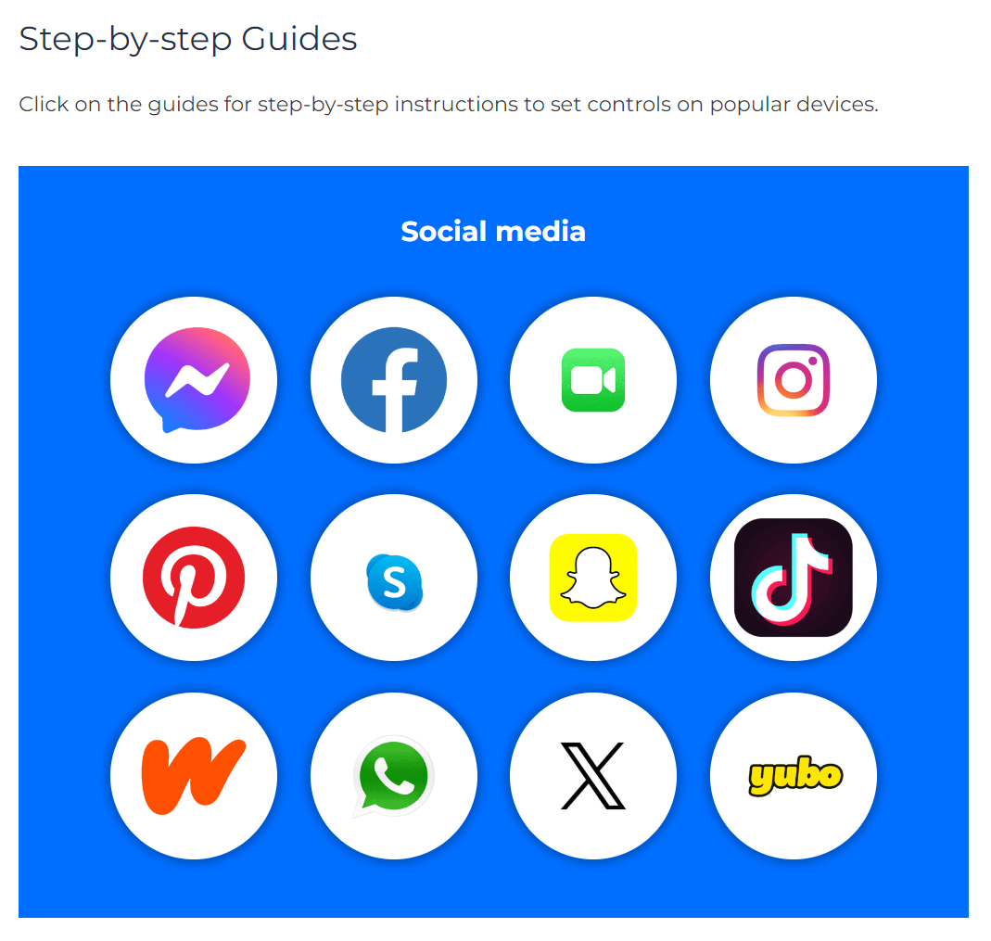
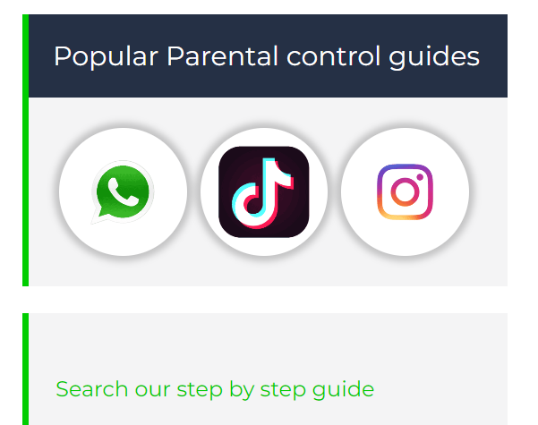
Do YOU know HOW TO REPORT to apps / sites?
Internet Matters has helpful guides for social media apps and sites at internetmatters.org/parental-controls/social-media
Notes:
Each social media site has it’s own processes for reporting inappropriate/harmful content.

Slide 16
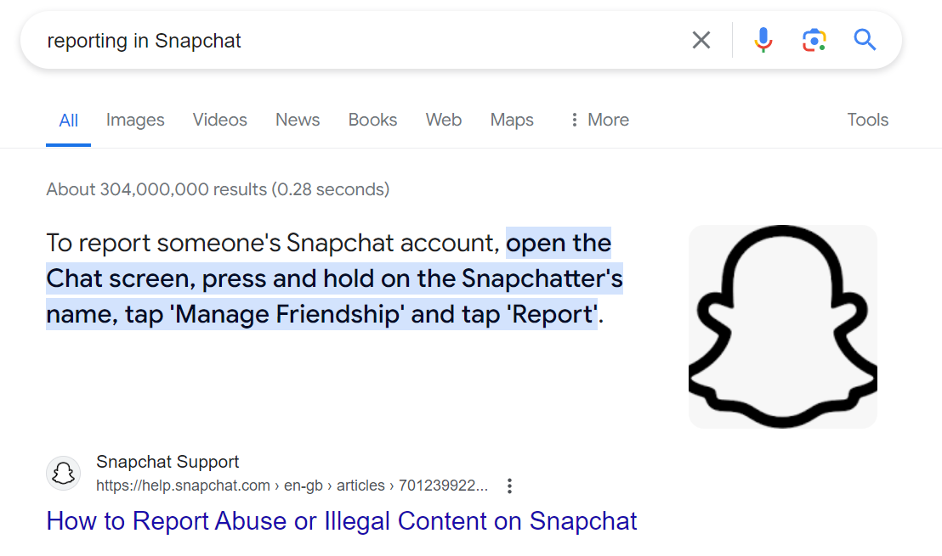
A simple Google search with the site name, e.g. ‘reporting in Snapchat’ will bring up the steps to take and signpost to the reporting page
Notes:
TELL – you can also do a Google search by typing ‘reporting in______________________________ (name of platform)’

Slide 17
Remember!
Before signing up to any app/site, check that your child meets the minimum age requirement for the platform to understand the risks
Remind your child to be cautious about accepting friend requests - a real friend is someone they/you know in real life, not a ‘friend’ they met gaming or in a chat room. Encourage them to ask you for advice if they are unsure.
Stress the importance of not sharing personal information with online ‘friends’
Keep passwords confidential
Check their privacy settings, emphasising the importance of not sharing personal information with strangers, and emphasising the confidentiality of passwords are all important steps
You can report any content, e.g. a post, image or harmful, misleading or damaging comment
Remember that reporting doesn't guarantee immediate removal, as platforms assess reported content based on their respective rules and policies

Slide 18




UK Reporting Helplines and Services for Children and Young People
NCA
Young people can report concerns about child sexual abuse and exploitation to NCA
Report Remove
A free tool that allows children to report nude or sexual images and videos of themselves that they think might have been shared online
ChildLine
A free, private and confidential service where CYP can talk about anything to a trained counsellor, online or on the phone
Call 101 or 999 if there is an immediate risk of harm to your child
Go to reporting.lgfl.net to find out more
Notes:
TELL – Talk to your children about these free reporting helplines to support them if they are worried.
For older children, The Mix provides help for young people aged 11-25

